Slide 1
DO NOW:
Materials move through cells by diffusion. Oxygen and food move into cells, while waste products move out of cells. How does the size of a cell affect how efficiently materials get to all parts of a cell?
On a sheet of paper, make a drawing of a cell that has the following dimensions: 5 cm x 5 cm x 5 cm. Draw another cell about one half the size of your cell next to the first cell as shown.
Compare both cells.
Draw an oxygen molecule in the center of each cell.

Slide 2
DO NOW:
How much longer do you think it would take an oxygen molecule to get from the cell membrane to the center of the big cell than from the cell membrane to the center of the smaller cell?
What is the advantage of cells being small?
How do you think cells solve the problem of being too big?
Write a proper title for your poster

Slide 3
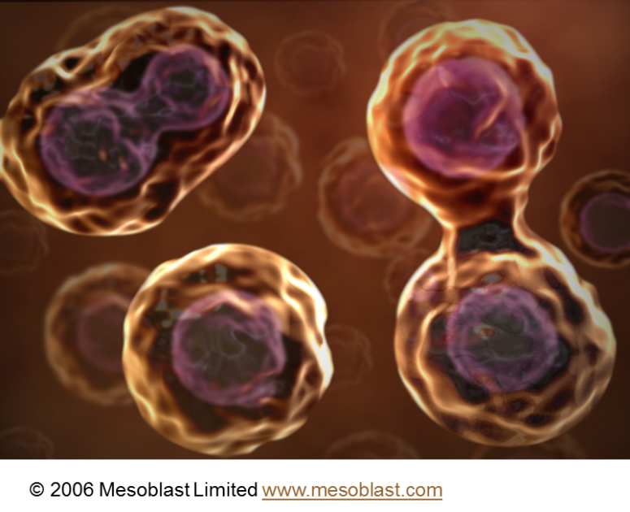
Chapter 10_ Cell Growth and Division
Essential Question:
Why and how do cells divide?
http://plaza.ufl.edu/alallen/pgl/modules/rio/stingarees/module/why.html

Slide 4
How does the size of a cell affect how efficiently materials get to all parts of a cell?
How much longer do you think it would take an oxygen molecule to get from the cell membrane to the center of the big cell than from the cell membrane to the center of the smaller cell?
A/ It could take twice the amount of time.
2. What is the advantage of cells being small?
A/ Being smaller helps the cell moves materials faster, so it is more efficient.
3. How do you think cells solve the problem of being too big?
A/ They go through cell division

Slide 5
10–1 Cell Growth
A. Limits to Cell Growth
1. DNA “Overload”
2. Exchanging Materials
3. Ratio of Surface Area to Volume
4. Cell Division and Reproduction

Slide 6
Ratio of Surface Area to Volume in Cells
Cell Size
Surface Area (length x width x 6)
Volume
(length x width x height)
Ratio of Surface Area to Volume

Slide 7
Cell division is a fundamental process
All cells come from pre-existing cells
It is necessary to replace worn out cells, and repair tissues in multicellular organisms
It is required for growth in multicellular organisms
An increase in size will require an increase in surface area to volume ration
Cell division subdivides the cytoplasm into small units (cells) surrounded by plasma membranes
It is necessary for reproduction in unicellular or multicellular organisms

Slide 8
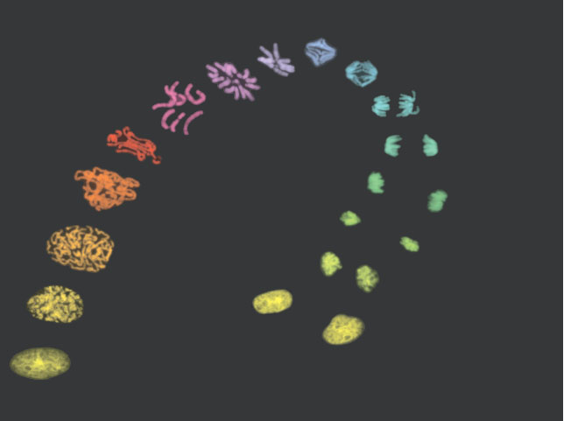
The continuity of life
Is based upon the reproduction of cells, or cell division

Slide 9
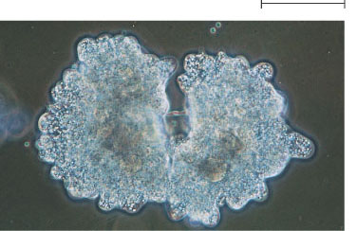
Unicellular organisms
Reproduce by cell division
100 µm
(a) Reproduction. An amoeba, a single-celled eukaryote, is dividing into two cells. Each new cell will be an individual identical organism (LM).

Slide 10
Multicellular organisms depend on cell division for
Development from a fertilized cell
Growth
Repair
200 µm
20 µm
(b) Growth and development. This micrograph shows a sand dollar embryo shortly after the fertilized egg divided, forming two cells (LM).
(c) Tissue renewal. These dividing bone marrow cells (arrow) will give rise to new blood cells (LM).

Slide 11
Reproduction
Asexual Reproduction
Sexual Reproduction
Offspring acquire genes from parents by inheriting chromosomes.

Slide 14
Words to know
Diploid: containing the entire set of chromosomes for its species (Ex: in humans 46 chromosomes)
Haploid: containing only half the number of chromosomes, than in the other cells of the body (in humans 23 chromosomes)
Gametes: specialized cells involved in sexual reproduction- also known as sex cells (sperm and egg)

Slide 16
Some organisms are capable of reproducing asexually through processes such as budding or parthenogenesis. What is an advantage of asexual production for an organism?
A. | It allows organisms to increase population rapidly.
B. | It allows haploid cells to unite to produce a zygote.
C. | It allows for greater genetic diversity within a species.
D. | It allows crossing over to take place during replication.

Slide 17
Inheritance is possible because:
DNA is precisely replicated producing copies of genes that can be passed along from parents to offspring.
Fertilization: Sperm and ova (egg) carrying each parent's genes are combined in the nucleus of the fertilized egg.
DNA - Type of nucleic acid that is a polymer of four different kinds of nucleotides.
Genes - Units of hereditary information that are made of DNA and are located on chromosomes.

Slide 18
10–2 Cell Division
A. Chromosomes
B. The Cell Cycle
C. Events of the Cell Cycle
D. Mitosis
1. Prophase
2. Metaphase
3. Anaphase
4. Telophase
E. Cytokinesis

Slide 19
The cell division process
Is an integral part of the cell cycle
Cell division results in genetically identical daughter cells
Cells duplicate their genetic material
Before they divide, ensuring that each daughter cell receives an exact copy of the genetic material, DNA

Slide 20
Chromosomes
A cell’s endowment of DNA, its genetic information
Is called its genome

Slide 21
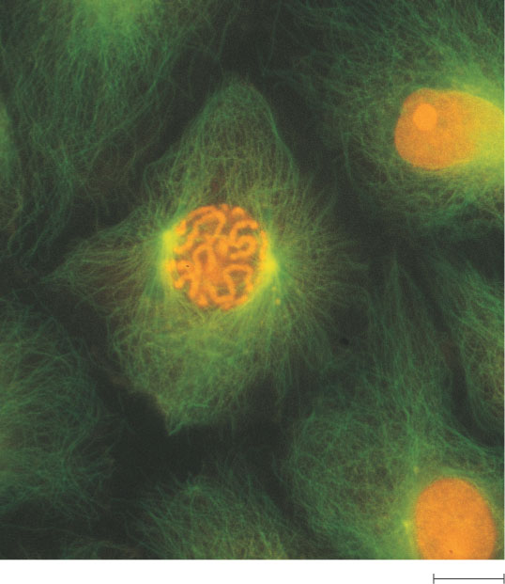
The DNA molecules in a cell
Are packaged into chromosomes
50 µm

Slide 22
Eukaryotic chromosomes
Consist of chromatin, a complex of DNA and protein that condenses during cell division
In animals
Somatic cells have two sets of chromosomes
Gametes have one set of chromosomes

Slide 23
In preparation for cell division
DNA is replicated and the chromosomes condense

Slide 24
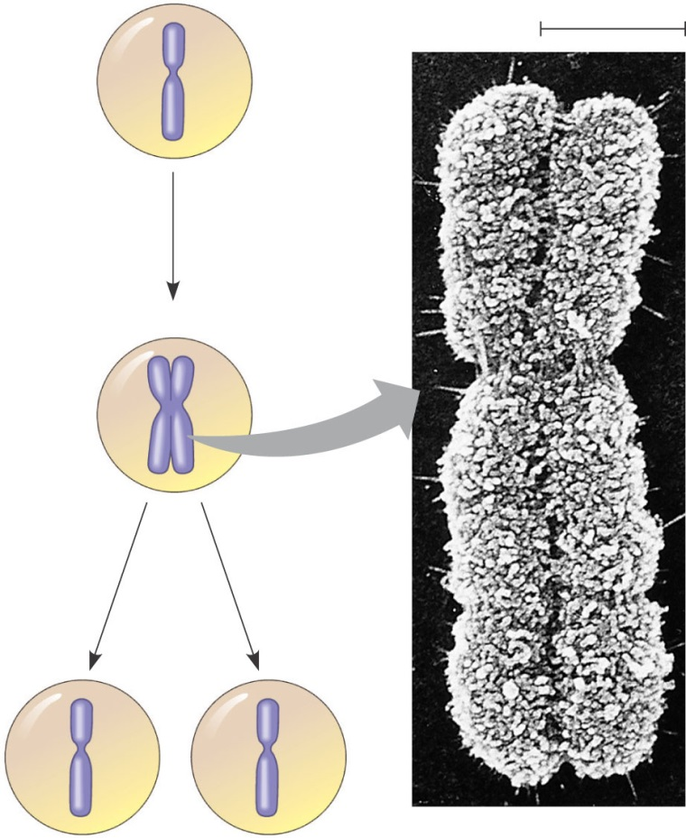
Each duplicated chromosome
Has two sister chromatids, which separate during cell division
A eukaryotic cell has multiple chromosomes, one of which is represented here. Before duplication, each chromosome has a single DNA molecule.
0.5 µm
Chromosome duplication (including DNA synthesis)
Once duplicated, a chromosome consists of two sister chromatids connected at the centromere. Each chromatid contains a copy of the DNA molecule.
Centromere
Sister chromatids
Separation of sister chromatids
Mechanical processes separate the sister chromatids into two chromosomes and distribute them to two daughter cells.
Figure 12.4
Centromeres
Sister chromatids

Slide 25
Eukaryotic cell division consists of
Mitosis, the division of the nucleus
Cytokinesis, the division of the cytoplasm
In meiosis
Sex cells are produced after a reduction in chromosome number

Slide 26
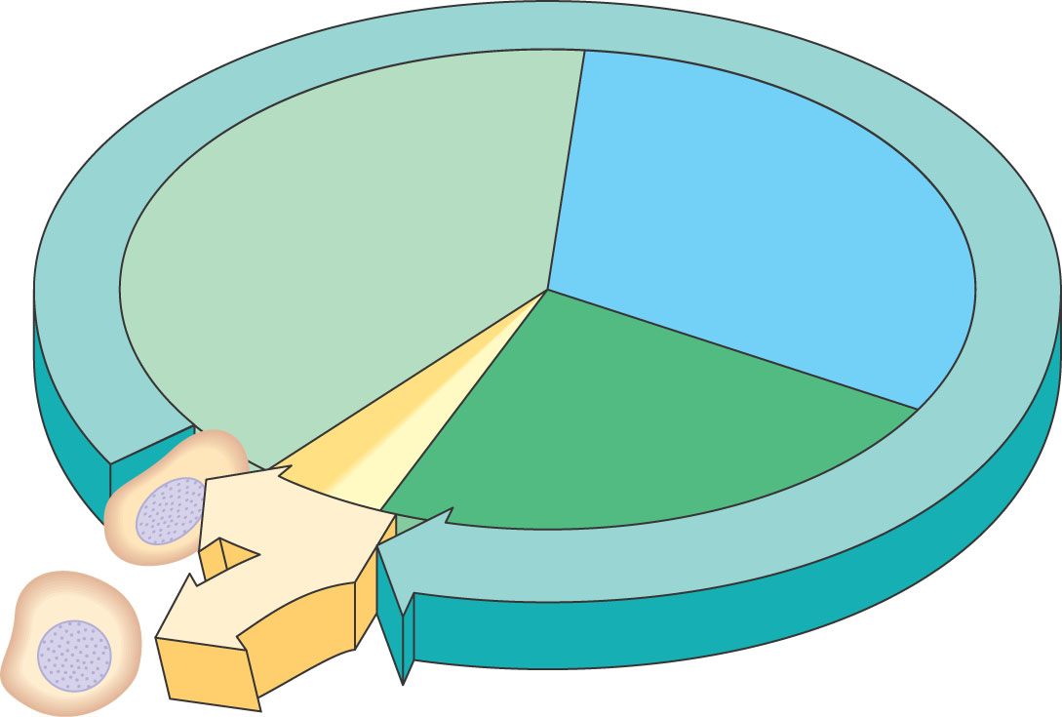
Phases of the Cell Cycle
The cell cycle consists of
Interphase
The mitotic phase
INTERPHASE
S (DNA synthesis)
G₁
Cytokinesis Mitosis
G₂
MITOTIC (M) PHASE
Figure 12.5

Slide 27
Interphase
G1 phase. Metabolic changes prepare the cell for division. At a certain point - the restriction point - the cell is committed to division and moves into the S phase.
S phase. DNA synthesis replicates the genetic material. Each chromosome now consists of two sister chromatids.
G2 phase. Metabolic changes assemble the cytoplasmic materials necessary for mitosis and cytokinesis.

Slide 28
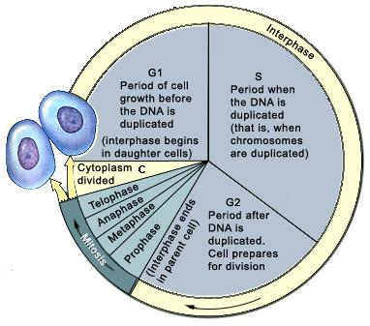

Slide 29
M phase
A nuclear division (mitosis) followed by a cell division (cytokinesis).

Slide 30
Concept Map
Section 10-2
Cell Cycle
includes
Interphase
M phase
(Mitosis)
is divided into
is divided into
G₁ phase
S phase
G₂ phase
Prophase
Metaphase
Anaphase
Telophase

Slide 31
Which of the following is a correct statement about the events of the cell cycle?
a. Little happens during the G₁ and G₂ phases.
b. DNA replicates during cytokinesis.
c. The M phase is usually the longest phase.
d. Interphase consists of the G₁, S, and G₂ phases.

Slide 32
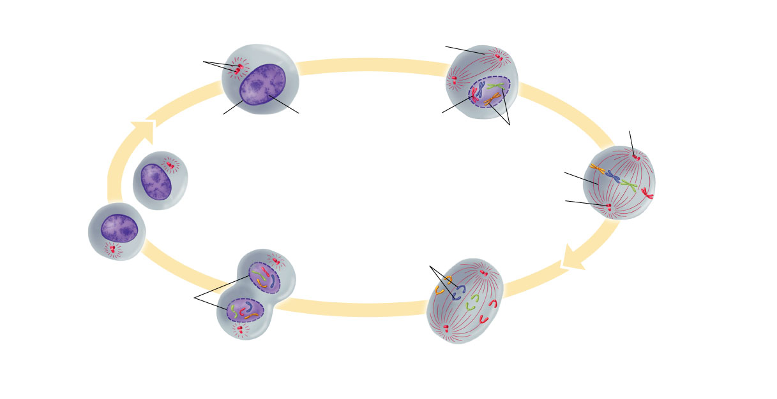
Figure 10–5 Mitosis and Cytokinesis
Section 10-2
Spindle forming
Centrioles
Nuclear envelope
Chromatin
Centromere
Centriole
Chromosomes (paired chromatids)
Interphase
Prophase
Spindle
Cytokinesis
Centriole
Individual chromosomes
Metaphase
Telophase
Nuclear envelope reforming
Anaphase

Slide 33
Figure 10–5 Mitosis and Cytokinesis
Section 10-2
Spindle forming
Centrioles
Nuclear envelope
Chromatin
Centromere
Centriole
Chromosomes (paired chromatids)
Interphase
Prophase
Spindle
Cytokinesis
Centriole
Individual chromosomes
Metaphase
Telophase
Nuclear envelope reforming
Anaphase

Slide 34
Figure 10–5 Mitosis and Cytokinesis
Section 10-2
Spindle forming
Centrioles
Nuclear envelope
Chromatin
Centromere
Centriole
Chromosomes (paired chromatids)
Interphase
Prophase
Spindle
Cytokinesis
Centriole
Individual chromosomes
Metaphase
Telophase
Nuclear envelope reforming
Anaphase

Slide 35
Figure 10–5 Mitosis and Cytokinesis
Section 10-2
Spindle forming
Centrioles
Nuclear envelope
Chromatin
Centromere
Centriole
Chromosomes (paired chromatids)
Interphase
Prophase
Spindle
Cytokinesis
Centriole
Individual chromosomes
Metaphase
Telophase
Nuclear envelope reforming
Anaphase

Slide 36
Figure 10–5 Mitosis and Cytokinesis
Section 10-2
Spindle forming
Centrioles
Nuclear envelope
Chromatin
Centromere
Centriole
Chromosomes (paired chromatids)
Interphase
Prophase
Spindle
Cytokinesis
Centriole
Individual chromosomes
Metaphase
Telophase
Nuclear envelope reforming
Anaphase

Slide 37
Figure 10–5 Mitosis and Cytokinesis
Section 10-2
Spindle forming
Centrioles
Nuclear envelope
Chromatin
Centromere
Centriole
Chromosomes (paired chromatids)
Interphase
Prophase
Spindle
Cytokinesis
Centriole
Individual chromosomes
Metaphase
Telophase
Nuclear envelope reforming
Anaphase

Slide 38
The Mitotic Spindle: A Closer Look
The mitotic spindle
Is an apparatus of microtubules that controls chromosome movement during mitosis
The spindle arises from the centrosomes
And includes spindle microtubules and asters

Slide 39
Nonkinetechore microtubules from opposite poles
Overlap and push against each other, elongating the cell
In telophase
Genetically identical daughter nuclei form at opposite ends of the cell

Slide 40
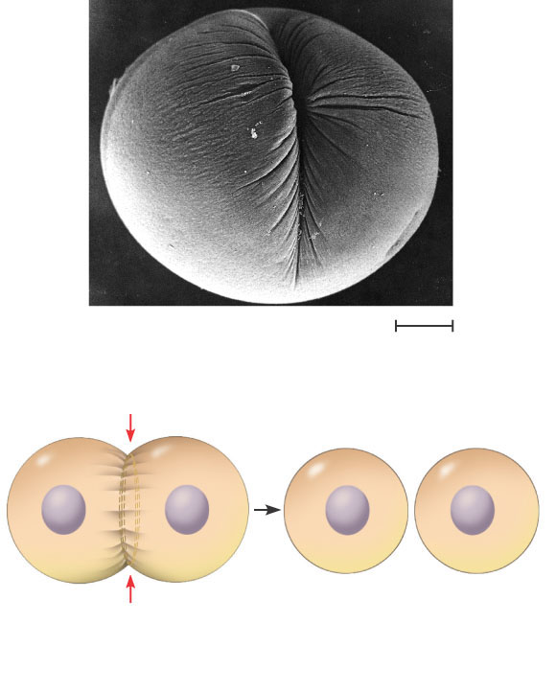
Cytokinesis: A Closer Look
In animal cells
Cytokinesis occurs by a process known as cleavage, forming a cleavage furrow
Cleavage furrow
100 µm
Contractile ring of microfilaments
Daughter cells
Figure 12.9 A
(a) Cleavage of an animal cell (SEM)

Slide 41
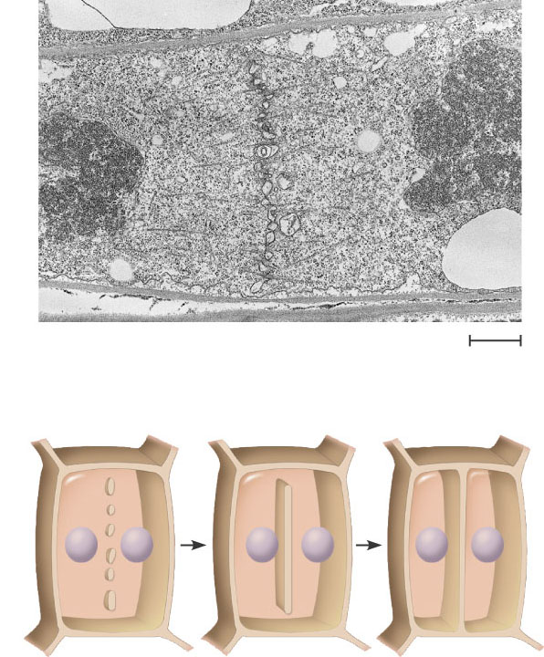
In plant cells, during cytokinesis
A cell plate forms
Vesicles forming cell plate
Wall of patent cell
1 µm
Cell plate
New cell wall
Daughter cells
Figure 12.9 B
(b) Cell plate formation in a plant cell (SEM)

Slide 42
Mitosis in a plant cell
Nucleus
Chromatine condensing
Chromosome
Nucleolus
Prophase. The chromatin is condensing. The nucleolus is beginning to disappear. Although not yet visible in the micrograph, the mitotic spindle is staring to from.
2
Prometaphase. We now see discrete chromosomes; each consists of two identical sister chromatids. Later in prometaphase, the nuclear envelop will fragment.
Metaphase. The spindle is complete, and the chromosomes, attached to microtubules at their kinetochores, are all at the metaphase plate.
Anaphase. The chromatids of each chromosome have separated, and the daughter chromosomes are moving to the ends of cell as their kinetochore microtubles shorten.
Telophase. Daughter nuclei are forming. Meanwhile, cytokinesis has started: The cell plate, which will divided the cytoplasm in two, is growing toward the perimeter of the parent cell.
1
3
4
5
Figure 12.10

Slide 43
Mitosis video https://www.youtube.com/watch?v=AhgRhXl7w_g
Animation:
http://www.youtube.com/watch?v=JcZQkmooyPk&index=8&list=PLXwnjgs_UWpIQhMZ1YObcd338AHkQzPHW

Slide 44
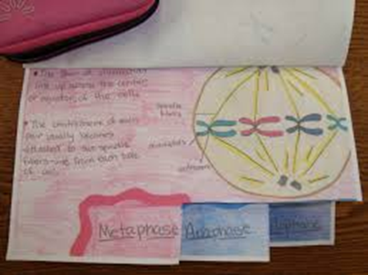
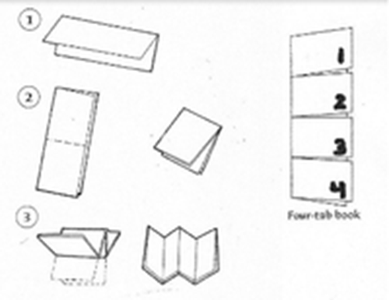
Cell Cycle and Division Product
Make a foldable organizer including the following:
Interphase:
G₁ phase
S phase
G₂ phase
The mitotic phase:
mitosis and
cytokinesis

Slide 46
Binary Fission
Prokaryotes (bacteria)
Reproduce by a type of cell division called binary fission
The bacterial chromosome replicates
The two daughter chromosomes actively move apart

Slide 47
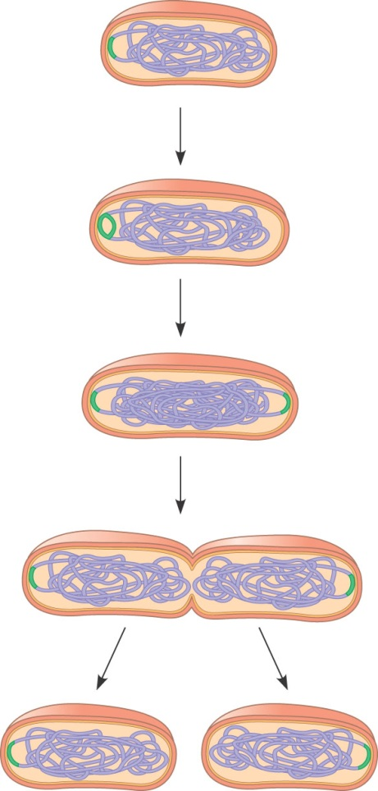
Origin of
replication
Cell wall
1. Chromosome replication begins. Soon thereafter, one copy of the origin moves rapidly toward the other end of the cell.
Plasma
Membrane
E. coli cell
Bacterial
Chromosome
Two copies
of origin
2. Replication continues. One copy of the origin is now at each end of the cell.
Origin
Origin
3. Replication finishes. The plasma membrane grows inward, and
new cell wall is deposited.
4. Two identical daughter cells result.

Slide 48
The Evolution of Mitosis
Since prokaryotes preceded eukaryotes by billions of years
It is likely that mitosis evolved from bacterial cell division
Certain protists
Exhibit types of cell division that seem intermediate between binary fission and mitosis carried out by most eukaryotic cells

Slide 49
The cell cycle is regulated by a molecular control system
The frequency of cell division
Varies with the type of cell
These cell cycle differences
Result from regulation at the molecular level

Slide 50
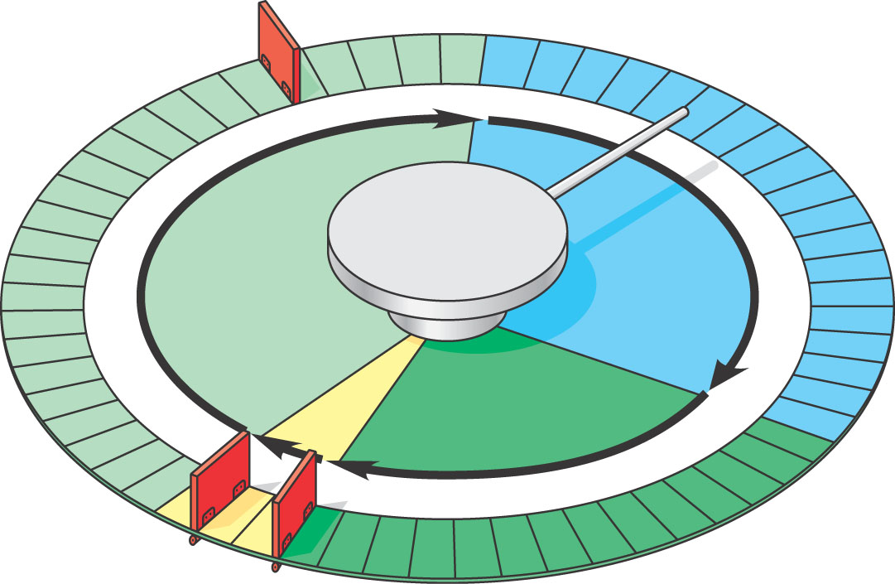
The Cell Cycle Control System
The sequential events of the cell cycle
Are directed by a distinct cell cycle control system, which is similar to a clock
G₁ checkpoint
Control system
S
G₁
M
G₂
M checkpoint
Figure 12.14
G₂ checkpoint

Slide 51
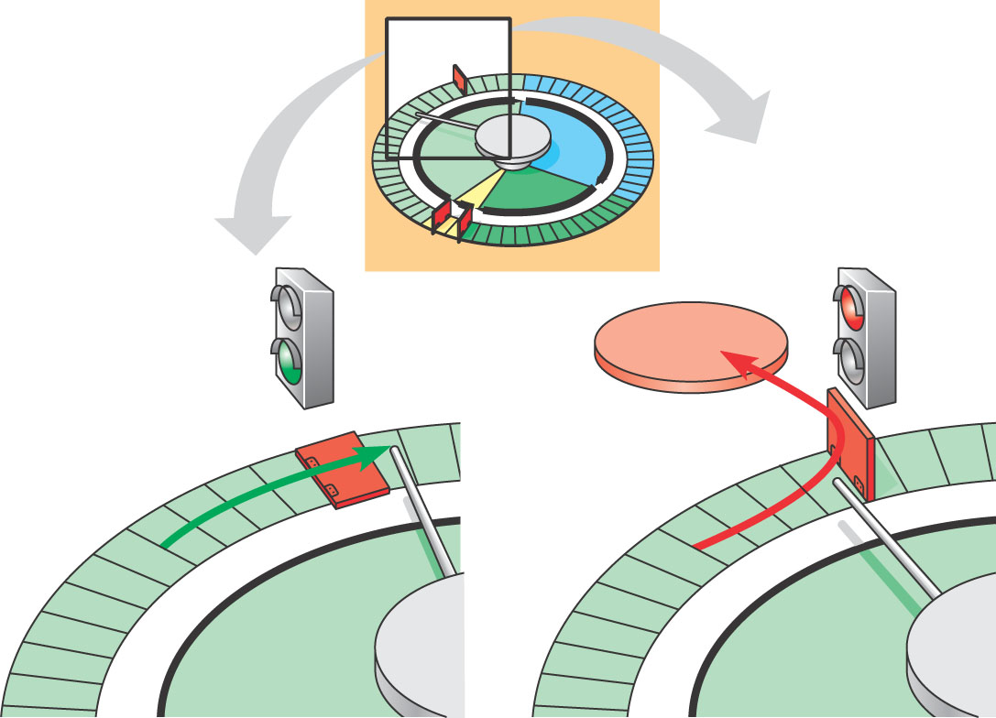
The clock has specific checkpoints
Where the cell cycle stops until a go-ahead signal is received
G₀
G₁ checkpoint
G₁
G₁
(b) If a cell does not receive a go-ahead signal at the G₁checkpoint, the cell exits the cell cycle and goes into G₀, a
nondividing state.
(a) If a cell receives a go-ahead signal at the G₁ checkpoint, the cell continues on in the cell cycle.

Slide 52
The Cell Cycle Clock: Cyclins and Cyclin-Dependent Kinases
Two types of regulatory proteins are involved in cell cycle control
Cyclins and cyclin-dependent kinases (Cdks)

Slide 53
Stop and Go Signs: Internal and External Signals at the Checkpoints
Both internal and external signals
Control the cell cycle checkpoints

Slide 54
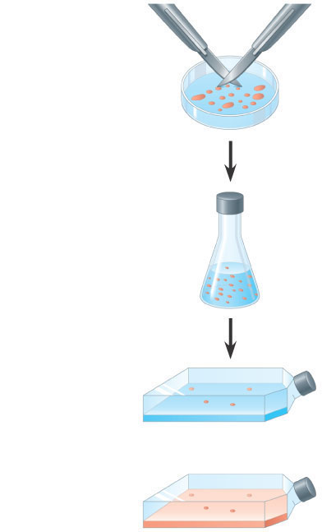
Growth factors stimulate other cells to divide
EXPERIMENT
Scalpels
1
A sample of connective tissue was cut up into small pieces.
Petri plate
2
Enzymes were used to digest the extracellular matrix, resulting in a suspension of free fibroblast cells.
3
Cells were transferred to sterile culture vessels containing a basic growth medium consisting of glucose, amino acids, salts, and antibiotics (as a precaution against bacterial growth). PDGF was added to half the vessels. The culture vessels were incubated at 37°C.
Without PDGF
Figure 12.17
With PDGF

Slide 55
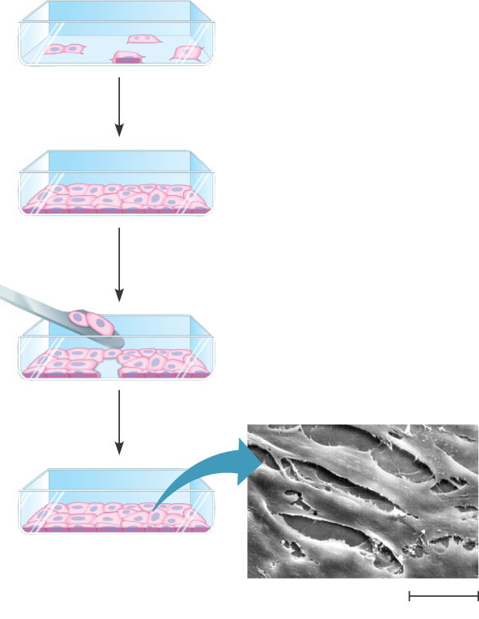
In density-dependent inhibition
Crowded cells stop dividing
Most animal cells exhibit anchorage dependence
In which they must be attached to a substratum to divide
(a)
Normal mammalian cells. The availability of nutrients, growth factors, and a substratum for attachment limits cell density to a single layer.
Cells anchor to dish surface and
divide (anchorage dependence).
When cells have formed a complete single layer, they stop dividing (density-dependent inhibition).
If some cells are scraped away, the remaining cells divide to fill the gap and then stop (density-dependent inhibition).
Figure 12.18 A
25 µm

Slide 56
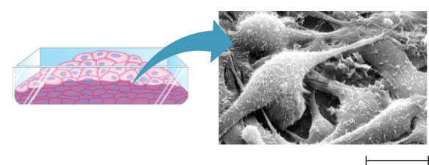
Cancer cells
Exhibit neither density-dependent inhibition nor anchorage dependence
Cancer cells do not exhibit anchorage dependence or density-dependent inhibition.
(b)
Cancer cells. Cancer cells usually continue to divide well beyond a single layer, forming a clump of overlapping cells.
Figure 12.18 B
25 µm

Slide 57
Loss of Cell Cycle Controls in Cancer Cells
Cancer cells
Do not respond normally to the body’s control mechanisms
Form tumors

Slide 58
Malignant tumors invade surrounding tissues and can metastasize
Exporting cancer cells to other parts of the body where they may form secondary tumors
Tumor
Lymph vessel
Blood vessel
Glandular
tissue
Cancer cell
Metastatic Tumor
1
A tumor grows from a single cancer cell.
2
Cancer cells invade neighboring tissue.
3
Cancer cells spread through lymph and blood vessels to
other parts of the body.
4
A small percentage of cancer cells may survive and establish a new tumor in another part of the body.
Figure 12.19

