Slide 1
13.3_Mutations
SC.912.L.16.4
Explain how mutations in DNA sequence may or may not result in phenotypic change.
Explain how mutations in gametes may result in phenotypic changes in offspring.
By Dr. J. Suris Soto

Slide 2
Objectives
By the end of this lesson you will be able to:
Describe the different types of mutation and how they occur.
Explain how mutations increase genetic diversity in a population.

Slide 3
Mutations
Mutations are changes of an individual’s genetic information.
Can occur in
Somatic cells (Body cells)
Cannot be inherited
can lead to cancer- like skin cancer
Gametes (Sex cells- egg and sperm)
Which can lead to changes of the DNA of offspring
Can cause cancer family syndrome
These are more notable, because they introduce genetic and possible phenotypic changes in the population

Slide 5
Is a mutation natural or man made?
A mutation is natural
Spontaneous mutations can occur during DNA replication, recombination, or repair
Caused by mutagens- physical or chemical agents in the environment.
Physical Mutagens:
Some forms of electromagnetic radiation (X-rays and Ultra Violet light)
Chemical Mutagens:
Pesticides
Some natural plant alkaloids
Tobacco smoke
Environmental pollutants
Cells can sometimes repair the damage, but when they can’t, the DNA sequence changes permanently.

Slide 6
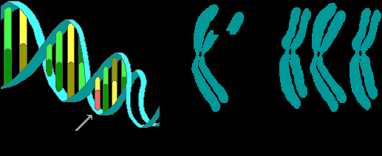
Types of mutations
Gene Mutations
Changes in a single base pair of a gene, also called point mutations
Chromosomal Mutations
Involves a change in the structure
Or the number of chromosomes

Slide 7
Mutations of genes, chromosome number or chromosome structure cause some genetic disorders.
Large-scale chromosomal alterations often lead to spontaneous abortions or cause a variety of developmental disorders

Slide 8
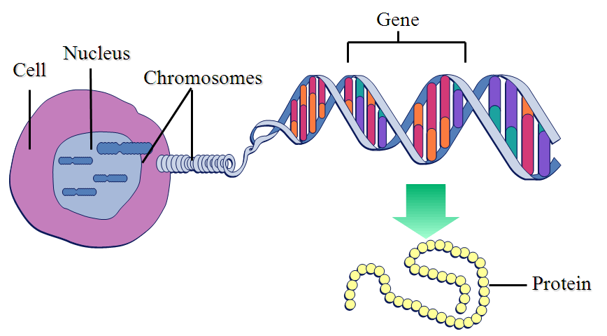
What Is a Gene? Revisiting the Question
A discrete unit of inheritance
A region of specific nucleotide sequence in a chromosome
A DNA sequence that codes for a specific polypeptide chain

Slide 9
Gene Mutations
Point mutations within a gene can be divided into two general categories
Nucleotide-pair substitutions
Frameshift Mutations
One or more nucleotide-pair insertions
or deletions

Slide 10
Substitutions
A nucleotide-pair substitution replaces one nucleotide and its partner with another pair of nucleotides
Silent mutations have no effect on the amino acid produced by a codon because of redundancy in the genetic code
Missense mutations still code for an amino acid, but not the correct amino acid
Nonsense mutations change an amino acid codon into a stop codon, nearly always leading to a nonfunctional protein

Slide 11
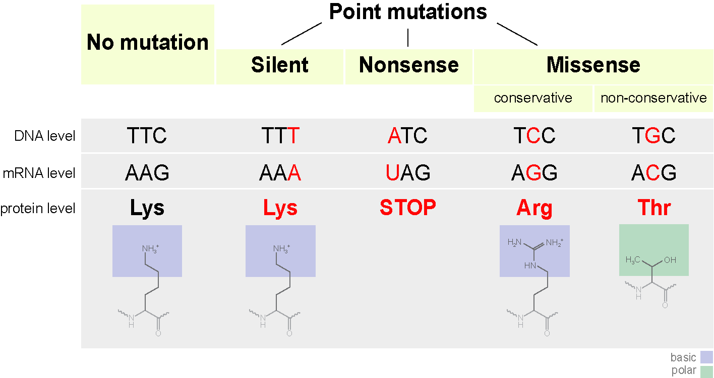
Gene Mutations: Substitution

Slide 12
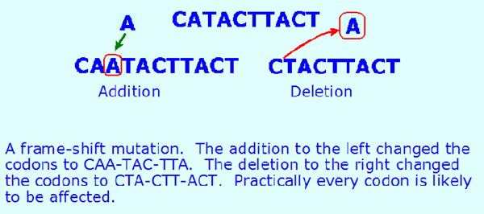
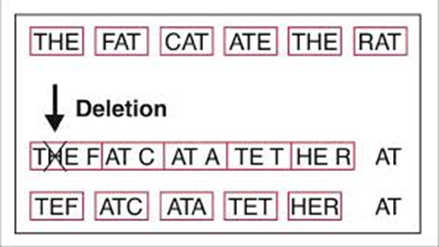
Insertions and Deletions
Insertions: addition of nucleotide pairs in a gene
Deletions: losses of nucleotide pairs in a gene
These mutations have a disastrous effect on the resulting protein more often than substitutions do
Insertion or deletion of nucleotides may alter the reading frame, producing a frameshift mutation
© 2011 Pearson Education, Inc.
Notes:
12

Slide 13
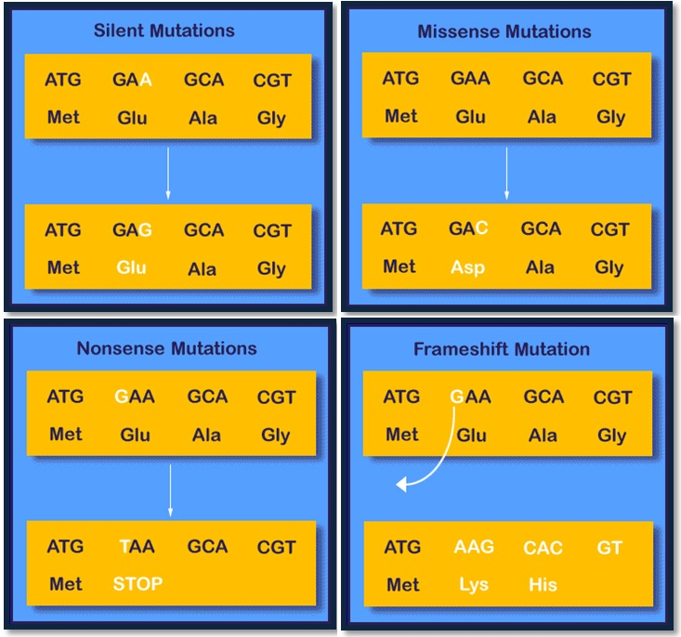

Slide 14
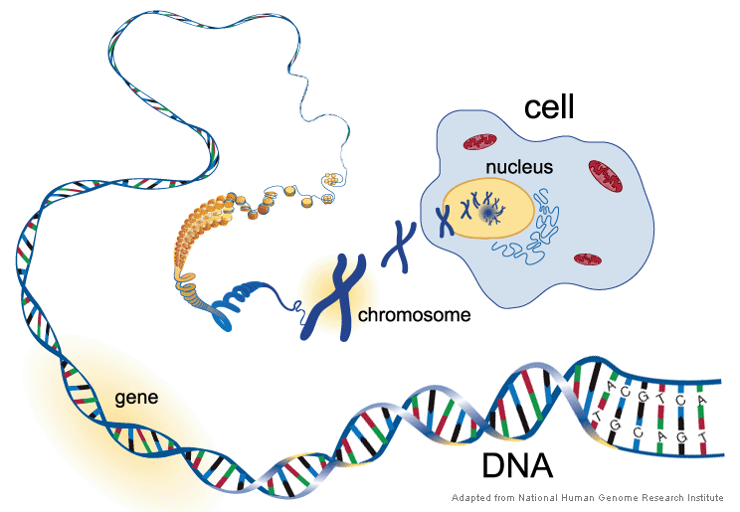
Chromosomal Mutations
Changes to the number of chromosomes
Changes to the structure of the chromosome

Slide 15
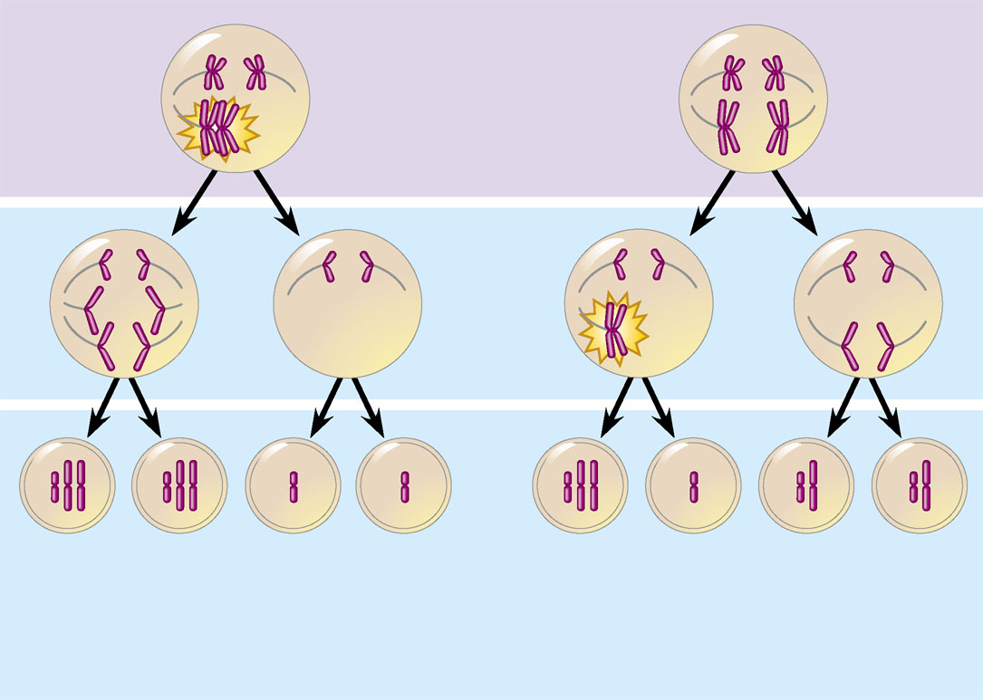
What causes an abnormal chromosome number?
Answer: Nondisjunction
A condition in which pairs of homologous chromosomes do not separate normally during meiosis I or Meiosis II
Meiosis I
As shown in the figure to the left
Nondisjunction in Meiosis I is more detrimental that in Meiosis II, because more gametes are affected, thus the offspring produced will have an extra, or a missing chromosome.
Nondisjunction
Meiosis II
Nondisjunction
Gametes
n + 1
n + 1
n  1
n – 1
n + 1
n –1
n
n
Number of chromosomes
(a)
Nondisjunction of homologous
chromosomes in meiosis I
(b)
Nondisjunction of sister
chromatids in meiosis II

Slide 16
Abnormal Chromosome Number
Aneuploidy
Is a condition in which offspring have an abnormal number of a particular chromosome
Results from the fertilization of gametes in which nondisjunction occurred
If a zygote is trisomic
It has three copies of a particular chromosome
If a zygote is monosomic
It has only one copy of a particular chromosome instead of the regular 2 copies inherited from the mother and the father.

Slide 17
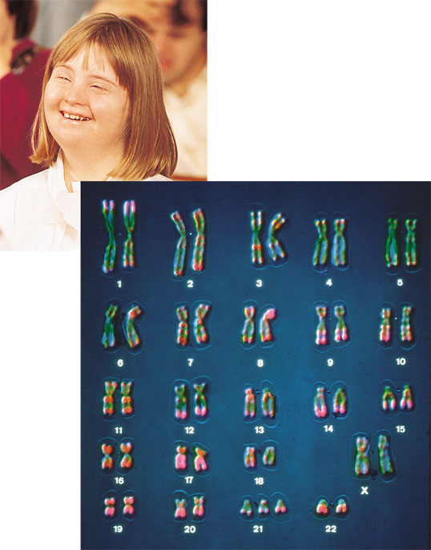
Abnormal Chromosome Number
Down syndrome
Is usually the result of an extra chromosome 21, trisomy 21
Caused by nondisjunction of the chromosomes 21
Extra chromosome on pair 21

Slide 18
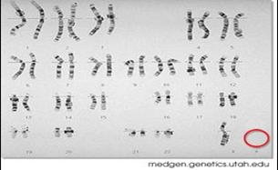
Aneuploidy of Sex Chromosomes
Nondisjunction of sex chromosomes (23rd pair)
Produces a variety of aneuploid conditions
Klinefelter syndrome
Is the result of an extra chromosome in a male, producing XXY individuals
Turner syndrome
Is the result of a missing chromosome
Called monosomy X,
producing an X0 karyotype

Slide 19
Alterations of Chromosome Structure
Breakage of a chromosome can lead to four types of changes in chromosome structure
Deletion
Duplication
Inversion
Translocation

Slide 20
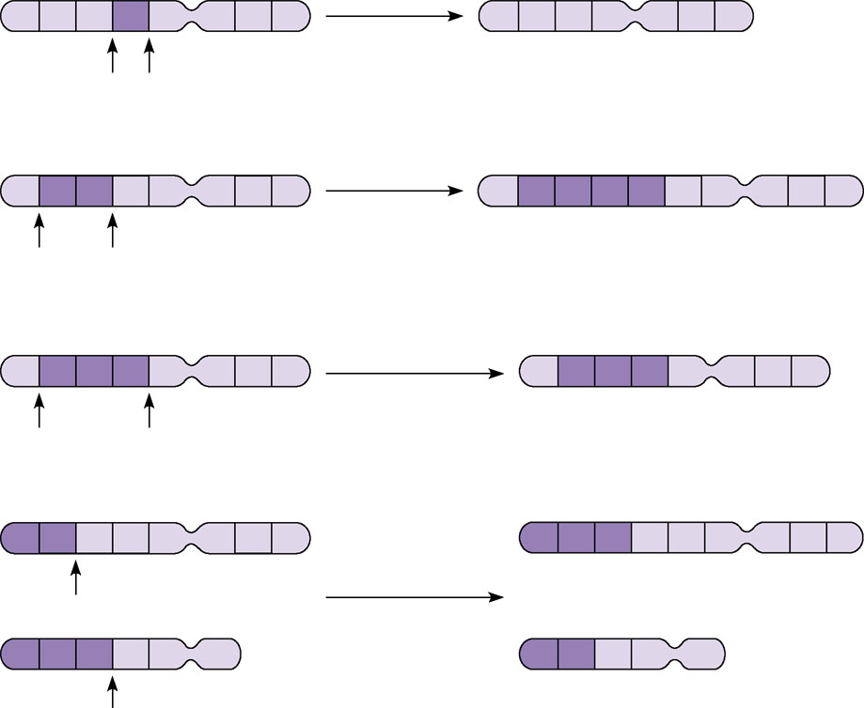
Alterations of chromosome structure
(a) A deletion removes a chromosomal
segment.
A
B
C
D
E
F
G
H
Deletion
A
B
C
E
F
G
H
(b) A duplication repeats a segment.
A
B
C
D
E
F
G
H
Duplication
A
B
C
B
C
D
E
F
G
H
(c) An inversion reverses a segment within a chromosome.
A
B
C
D
E
F
G
H
A
D
C
B
E
F
G
H
Inversion
(d) A translocation moves a segment from one chromosome to another,
nonhomologous one.
In a reciprocal translocation, the most common type, nonhomologous chromosomes exchange fragments.
Nonreciprocal translocations also occur, in which a chromosome transfers a fragment without receiving a fragment in return.
A
B
C
D
E
F
G
H
M
N
O
C
D
E
F
G
H
Reciprocal
translocation
M
N
O
P
Q
R
A
B
P
Q
R

Slide 21
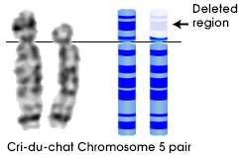
Disorders Caused by Structurally Altered Chromosomes
Cri du chat
Is a disorder caused by a deletion in a chromosome
learn.genetics.utah.edu

Slide 22
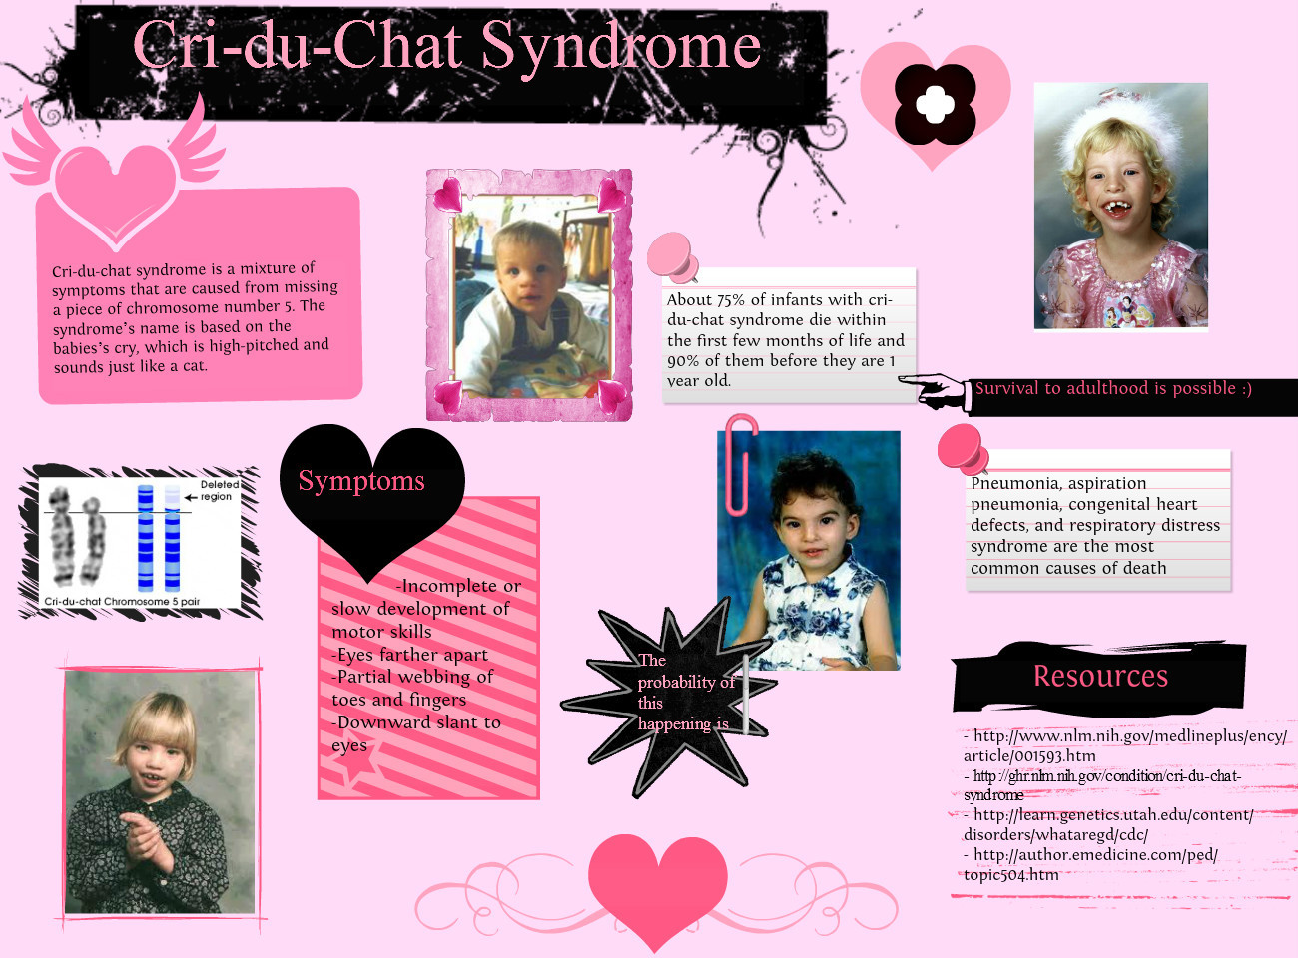

Slide 23
Certain cancers
Are caused by translocations of chromosomes
Normal chromosome 9
Reciprocal
translocation
Translocated chromosome 9
Philadelphia
chromosome
Normal chromosome 22
Translocated chromosome 22
Figure 15.16

Slide 24
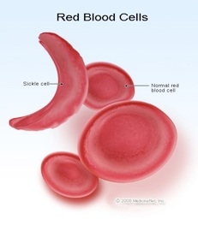
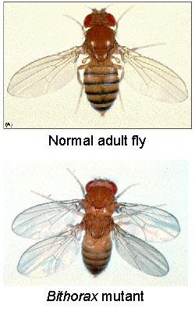
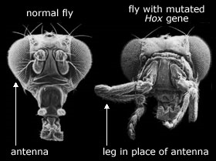
How do mutation affect the gene pool of a population?
Mutations introduce variants, (new phenotypes, or alleles) in a population.
Contribute to genetic diversity and to evolution.
Example: A new type of blood cell is now present in the human population.

Slide 25
What is a mutation?
A. the specific sequence of bases in a molecule of DNA
B. the perfect replication of a DNA molecule
C. the process by which a molecule of DNA makes a copy of itself.
D. a change in the genetic material.

Slide 26
Which type of mutation occurs when one base in DNA is replaced by another?
A. frameshift mutation
B. point mutation
C. chromosomal mutation
D. nondisjunction

Slide 27
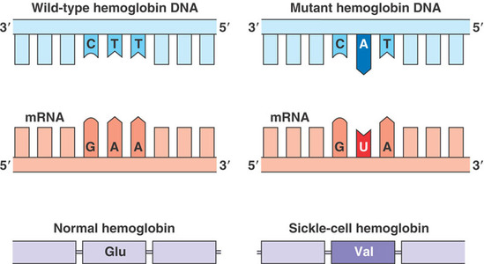
Which type of mutations is shown?
A. insertion
B. substitution
C. duplication
D. translocation

Slide 28
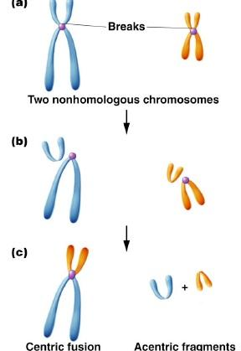
Which type of mutations is shown?
A. insertion
B. substitution
C. duplication
D. translocation

Slide 29
What is the cause of the mutation shown in the karyotype below?
A. inversion
B. frameshift
C. nondisjuntion
D. translocation

Slide 30
Consider the following statements:
I. Mutations always have a negative effect on an individual.
II. Mutations can have a positive effect on an individual.
III. Mutations can have no effect on an individual.
IV. Mutations can have a negative effect on an individual.
Which statement above is/are true?
A. I only
B. I and II only
C. II, III, and IV only
D. I, II, III, IV

