Slide 1
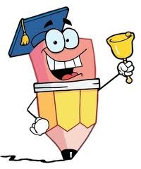
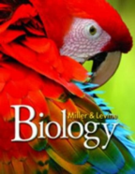
Bell Ringer 1 8/18/14 - 8/19/14
Chapter 1 Mystery Height By Prescription
(Biology Textbook Page 3)
Read the chapter Mystery
While you read take notes about the use of human growth hormone (HGH) in individuals who are short, but otherwise healthy.
As you read think (and jot down ideas) about how the Chapter Mystery illustrates the connection between science and society.

Slide 2
Chapter 1
The Science of Biology
Lesson 1 The Scientific Method

Slide 3
Lesson 1 Summary
Science is our knowledge of the natural world, and applications of that scientific knowledge are found in the various forms of technology that we use every day. It is important to remember that science is also a process used to acquire information about our natural world through observation, inquiry, rational thinking, and questioning.
When you have completed this lesson, you should be able to:
Explain what can be considered science and how science is practiced
Identify science vs. pseudoscience
Identify what types of questions can be answered by science
Apply the scientific method to a variety of scenarios
Design an experiment based on testable scientific questions
Distinguish between hypothesis, theories, and laws

Slide 4
Observation vs. Inference
Statement Observation Inference
Object A is round and orange.
X
Object A is a basketball.
X
X
Object A is a basketball.
Object B is a table-tennis
ball.
Object C is a soccer ball.
Object C is round and black and white.
Object C is larger than Object B.
X
Object B is smooth.
X
Object B is a table-tennis ball.
X
Each object is used in a different sport.
X
X

Slide 5
Did you know?
Science involves creativity.
Many people think that science just involves following a series of steps, with no room for creativity and inspiration.
To the contrary, most scientists describe creative thinking as one of the more important skills they have.
That creativity is used to develop an alternative hypothesis, devise a new way of testing an idea, or to look at old data in a new light.
Creativity is very important to the scientific process!

Slide 6
Science Checklist
Science…..
focuses on and attempts to explain the natural world,
supports its ideas with evidence,
involves scientists and other members of the scientific community,
furthers existing research and leads to new research,
and asks testable questions.

Slide 7
Is it Testable?
Let's examine the final characteristic from the science checklist more closely. Before you can begin a scientific investigation, you have to ask testable questions that have observable answers. See if you can identify the sample questions that can be tested by science.

Slide 8
Is it Testable?
Categorize each of the list items as testable or non-testable. (two-column)
What gives a person's life meaning?
How long does it take water to freeze?
Why should we value the environment?
Should mining for phosphates be stopped?
What career should I pursue after I graduate?
What gases make up the atmosphere of Earth?
What are the effects of high winds during a hurricane?
How many people live in an area prone to earthquake?
Should the use of coal and other fossil fuels be banned?
To what extent has climate changed over the past 100 years?

Slide 9
Answers
Testable
Non-testable
What gases make up the atmosphere of Earth?
To what extent has climate changed over the past 100 years?
How long does it take water to freeze?
What are the effects of high winds during a hurricane?
How many people live in an area prone to earthquake?
What gives a person's life meaning?
What career should I pursue after I graduate?
Why should we value the environment?
Should the use of coal and other fossil fuels be banned?
Should mining for phosphates be stopped?

Slide 10
What is NOT Science
Not every body of knowledge can be considered a science. You can know a lot about art, philosophy, and religion, but they are not considered fields of science.
Art, philosophy, and religion involve beliefs and opinions that cannot be tested by scientific experimentation and often extend beyond the natural world.
This does not make these fields any less valuable; it just means they are not considered science.
For example, science can be used to study living organisms and how different phenomena affect that organism’s life.
Scientific technology can even be used to help prevent diseases in order to extend someone’s life. However, science is not able to address questions about the meaning of life. This does not mean that questions like these are not important; they are just beyond the limits of science. These types of questions are better left to the fields of philosophy, art, and religion.

Slide 11
Pseudoscience
Sometimes a practice or belief claims to be science but does not follow the scientific method or cannot be proven reliable through experimentation. These practices are examples of pseudoscience, which literally means "fake science."

Slide 12
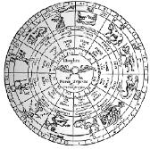
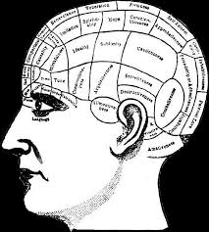
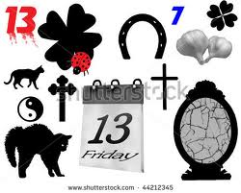
Pseudoscience
Astrology is the belief that information about the position of the stars can be used to make a reading about a person’s future, personality, and behavior. There is no solid body of experimental evidence to support these claims, so Astrology is not considered a science.
Phrenology was considered a science when it originated in the 1700s. It is the belief that people’s personality traits can be determined by “reading” bumps on their skulls. No experimental findings supported these claims, so Phrenology is considered a pseudoscience.
People sometimes believe that certain things will bring them good or bad luck. Some athletes may have a pregame ritual or a lucky charm that they think will help them play better. Superstitions and the belief in luck are not based on the scientific method and have not been proven reliable through scientific experimentation, so superstition is a pseudoscience.

Slide 13
Scientifically Reliable?
Many advertisements claim that medical treatments or herbal remedies are “scientifically proven.” When you are presented with information that claims to be scientifically proven, take a careful look at the information and ask yourself the following questions.
Has it been tested and observed numerous times by more than one group of scientists?
Is the study or data documented completely, and does it follow the scientific method?
Does the information contain just the facts and avoid mixing in opinion and assumption?
Is the information presented purely for public knowledge, avoiding being connected with a new product that is for sale?
Does the information come from a third party that is not profiting from the results of the study?
Has the study been retested by other scientists with the same results?
Are the results reported and published in a scientific journal?

Slide 14
Scientifically Reliable? Self-Check:
Yes: Be careful. This commercial has not provided enough evidence to support its claims. For the results to be scientifically reliable, they should be tested by an unbiased group of scientists who are not paid employees of the company. Also, the results of all studies should be documented completely so others can evaluate the reliability.
No: You are right. This commercial does not present evidence to support its claims. For the results to be scientifically reliable, they should be tested by an unbiased group of scientists who are not paid employees of the company. Also, the results of all studies should be documented completely so others can evaluate the reliability.
Based on the information provided, decide if each statement seems scientifically reliable.
A commercial advertising a diet pill says it is scientifically proven to help you lose weight. The doctor interviewed in the commercial is a paid employee of the company, and the fine print at the bottom of the screen says "results are not typical." Do the claims about this diet pill seem reliable?
Yes
No

Slide 15
Yes: You’re right! Dominic and Eva can be confident in the reliability of their data because they each conducted the measurements independently, and they repeated the measurements in multiple trials, with fairly consistent results.
No: Actually, Dominic and Eva can be confident in the reliability of their data because they each conducted the measurements independently, and they repeated the measurements in multiple trials, with fairly consistent results.
Dominic and Eva are using stopwatches to measure the time it takes for a chemical reaction to occur. They each use their own stopwatch to measure the time in seconds, and they repeat the experiment three times. These are their results:
Person Trial 1 Trial 2 Trial 3
Dominic 78 82 80
Eva 81 83 84
Do these results seem reliable?

Slide 16
Bell Ringer 1.2 8/20/14 – 8/21/14
Chapter 1 Mystery Clue
(Biology Textbook Page 8)
Describe a controlled experiment that can be design to test the hypothesis that extra HGH helps children grow taller.
What ethical concern scan you imagine in actually carrying out such study?

Slide 17
Scientific Process
You have probably seen the scientific method introduced as a series of steps in other science courses. These steps actually represent the format we follow for directed laboratory investigations in science classes and we use to write up the results of these studies.
However, it is important to remember that the scientific method is an oversimplification of how most scientists conduct investigations. The process of science involves many different people, engaged in a variety of activities and investigations. It is usually not a linear process, and the steps are not the same from one investigation to the next.
There is no one formula or series of steps that can be followed for all scientific investigations. However, all scientific investigations and methods are based on rational thinking, inquiry, and experimentation. Some or all of the following steps are likely to be included in the way most scientists perform investigations.

Slide 18
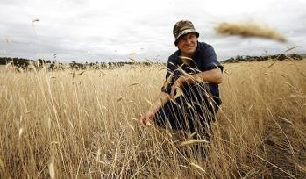
Purpose
http://resources3.news.com.au/images/2010/12/24/1225975/969691-steve-marsh.jpg
RUINED: Organic farmer Steve Marsh on his farm at Kojonup, about 300km southeast of Perth, which has been contaminated by GM canola seeds. Picture: Marie Nirme
The purpose of a scientific investigation is what you are trying to find out or the question you are trying to answer.
An initial observation (e.g., the sky is blue) will prompt an appropriate question (e.g., why is the sky blue?).
For example, in this picture you can see a farmer make observations about a dying crop. His question would be “What factors caused these plants to die?”

Slide 19
Research
You have learned that science is a body of knowledge.
It is important that you research what other scientists have already observed and discovered. It’s possible that someone has previously tested your observation or something related to it. If the farmer wishes to know why his plants are dying, he would research reasons why that type of plant might not grow.
The farmer might conduct this research at the library or a local garden center or on the Internet.

Slide 20
Avoiding Bias
Bias is a preconceived opinion or partiality that can influence the results of a test.
No matter how hard we try to be objective, bias can sneak into our research, observations, and judgments.
It is important that scientists do everything possible to avoid bias in their investigations.

Slide 21
Hypothesis
After researching what other scientists already know, the farmer will need to hypothesize about what he thinks will happen.
Forming a hypothesis involves an understanding of current scientific knowledge and creativity to look at the problem or question in a way that will lead to the predicted outcome.
For instance, the farmer notices that the dying plants seem to be yellow and brown, so he could conclude that there are not enough nutrients in the soil. He would form the hypothesis, “The lack of nutrients in the soil is causing the plants to die.”

Slide 22
Experimentation
The farmer would then design and carry out a test to try to get an answer to the original question and observation.
The farmer would record the data on a data sheet.
He will also want to write down the steps he used to carry out his experiment in case it needs to be repeated. This is called the procedure.
The farmer would make sure his procedure and data are accurately reported so that he could share the information with others or repeat the procedure at a later time.

Slide 23
Types of Data
Data are recorded observations or items of information; these fall into two categories
Qualitative data, or descriptions rather than measurements
For example, Jane Goodall’s observations of chimpanzee behavior
Quantitative data, or recorded measurements, which are sometimes organized into tables and graphs
© 2011 Pearson Education, Inc.

Slide 24
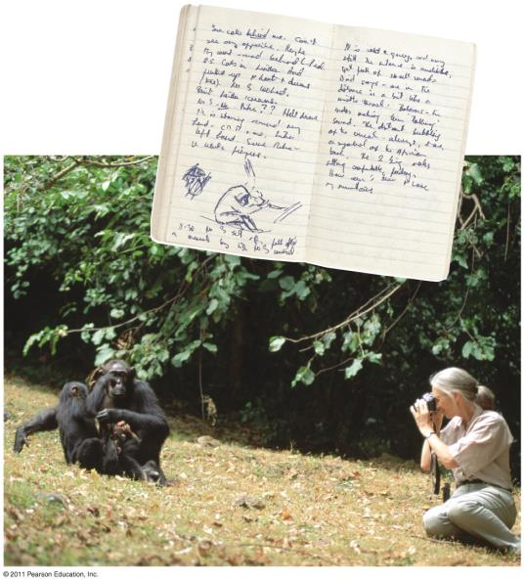
Qualitative data
Jane Goodall collecting qualitative data on chimpanzee behavior.

Slide 25
Variables
Scientists use experiments to search for relationships in nature and find answers to their questions. In other words, they design experiments to test if a change in one quantity or factor will affect another factor in the way their hypothesis predicted.
These changing quantities are called variables.
A variable is any factor or condition that can exist in differing amounts or types. An experiment usually has three kinds of variables: independent, dependent, and controlled.
The farmer would want to list all of the variables in his experiment, such as the amount of sunlight the plants receive, the temperature, the nutrients in the soil, the amount of water in the soil, and the type of plants.

Slide 26
Independent Variable
Is the one that the scientist has chosen to change within an experiment in order to test the hypothesis.
A good experiment should test, or vary, only one variable so the scientist can be confident that the observations made are a result of the changes made to the independent variable.
The farmer would change only the amount of nutrients in the soil. If he changed more than this variable, he would not know if the answer to his original question was correct.

Slide 27
Dependent Variable
The scientist will observe what happens to the dependent variable over the course of the experiment to see how it responds to the change made to the independent variable.
The observations made and data collected regarding the dependent variable are caused by, and depend on, the changes made to the independent variable.
By changing the amount of one nutrient in the soil, the farmer can see the results in the growth of his plants. The rate of plant growth or the health of the plant is the dependent variable. The change in the dependent variable “depends” on what is done with the independent variable.

Slide 28
Controlled Variables
Experiments also have controlled variables.
Controlled variables are the factors a scientist chooses to keep constant over the course of the experiment to make sure that anything that happens to the dependent variable is caused only by the independent variable.
In the example experiment, factors like temperature, water, and exposure to sunlight must be kept constant (controlled variables) in the soil to make sure any changes to the plant growth (dependent variable) are actually caused by the changes to the amount of nutrients in the soil (independent variable).

Slide 29
Analysis
The analysis of data from an experiment compares known and unknown values in the data.
The experiments are always repeated several times to make sure the results are valid. When an experiment is valid, it means the results are consistent over time and reproducible by you or by another scientist following the same procedure.
Based on the results of the farmer’s experiment, he would analyze the data by creating charts or graphs of the growth of the plants over time.

Slide 30
Conclusions
Based on the analysis of the collected data, a scientist will refer back to the original hypothesis and ask: Was the original hypothesis correct or incorrect?
Sometimes this is very simple and the conclusion is obvious. On occasion, finding that the hypothesis is incorrect leads to new discoveries.
Sometimes, the results are inconclusive, and the scientist must design a new experiment or complete further research.
If the farmer finds that the data supports the original hypothesis, he may conclude that the lack of soil nutrients caused the plants to grow poorly (i.e., analysis shows that changing the amount of nutrient causes the plants to grow faster).
On the other hand, the data might not support the original hypothesis (i.e., analysis shows that changing the amount of nutrient does not keep the plants from dying). In this case, he would try to change a different variable in the experiment, such as the amount of water, to retest his hypothesis.

Slide 32
Communicating Results
The most important step in any scientific investigation.
Publishing peer-reviewed articles in science journals allows researchers to share ideas and to test and evaluate each other’s work. This is conducted by anonymous, independent experts.
Peer-review does not guarantee that a piece of work is correct, but it does certify that the work meets standards set by the scientific community.
Science can change the world, but only if it is communicated effectively to the public and policy makers.
“Communication is not something you add on to science, it is of the essence of science.”

Slide 33
Let’s Practice
Which of the following questions can be answered through scientific investigation?
a. How does water pollution caused by drilling for oil in the ocean affect the marine ecosystems?
b. Why is the sky blue?
c. Should pesticides be banned?

Slide 34
Factors that a scientist chooses to keep constant over the course of the experiment are called
a. independent variables
b. dependent variables
c. controls

Slide 35
Researchers at a local plant nursery want to know if watering in the morning will help plants grow taller than watering at other times of the day. They water 20 tomato plants every day in the morning, 20 in the middle of the day, and 20 are the evening. What is the dependent variable?
A. Time of day when the plants are watered
B. The measured height of the plants
C. Amount of water

Slide 36
Researchers at a local plant nursery want to know if watering in the morning will help plants grow taller than watering at other times of the day. They water 20 tomato plants every day in the morning, 20 in the middle of the day, and 20 in the evening. What is a variable that should be controlled?
A. Time of day when the plants are watered
TB. he measured height of the plants
C. Amount of water

Slide 37
Katherine and Ruben wanted to determine what feature of a paper airplane would cause it to fly the farthest. Katherine’s airplane is short and wide with long wings, while Ruben’s is long and narrow with short wings. After testing the two airplanes three times, the results show that Katherine’s airplane flew farther through the air than Ruben’s airplane. They conclude that paper airplanes with long wings fly farther than paper airplanes with short wings. Is this a valid test and conclusion?
Yes
No

Slide 38
Katherine and Ruben wanted to determine what feature of a paper airplane would cause it to fly the farthest. Katherine’s airplane is short and wide with long wings, while Ruben’s is long and narrow with short wings. After testing the two airplanes three times, the results show that Katherine’s airplane flew farther through the air than Ruben’s airplane. Why isn’t this a valid test and conclusion?
A. The airplanes had more than one difference between them.
B. Factors such as force and height at release were not held constant.
C. Both A and B

