Slide 1
Chapter 1 The science of biology
Lesson 2 Characteristics of Life

Slide 2
Essential Questions:
What is biology?
What characteristics do all living things share?

Slide 3
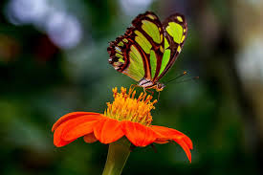
Bell Ringer: Is It Living?
Listed below are examples of living (which includes once-living) and nonliving things. Put an X next to the things that could be considered living.
___ tree
___ rock
___ fire
___ boy
___ wind
___ rabbit
___ cloud
___ feather
___ grass
___ seed
___ egg
___ bacteria
___ cell
___ molecule
___ Sun
___ mushroom
___ potato
___ leaf
___ butterfly
___ pupae
___ fossil
___ hibernating bear
___ mitochondria
___ river
Explain your thinking.
What “rule” or reasoning did you use to decide if something
could be considered living?

Slide 4
Biology is the scientific study of life
Biologists ask questions such as
How does a single cell develop into an organism?
How does the human mind work?
How do living things interact in communities?
Life defies a simple, one-sentence definition
Life is recognized by what living things do

Slide 5
Level in the Biological Hierarchy
Life can be studied at different levels, from molecules to the entire living planet
The study of life can be divided into different levels of biological organization

Slide 6
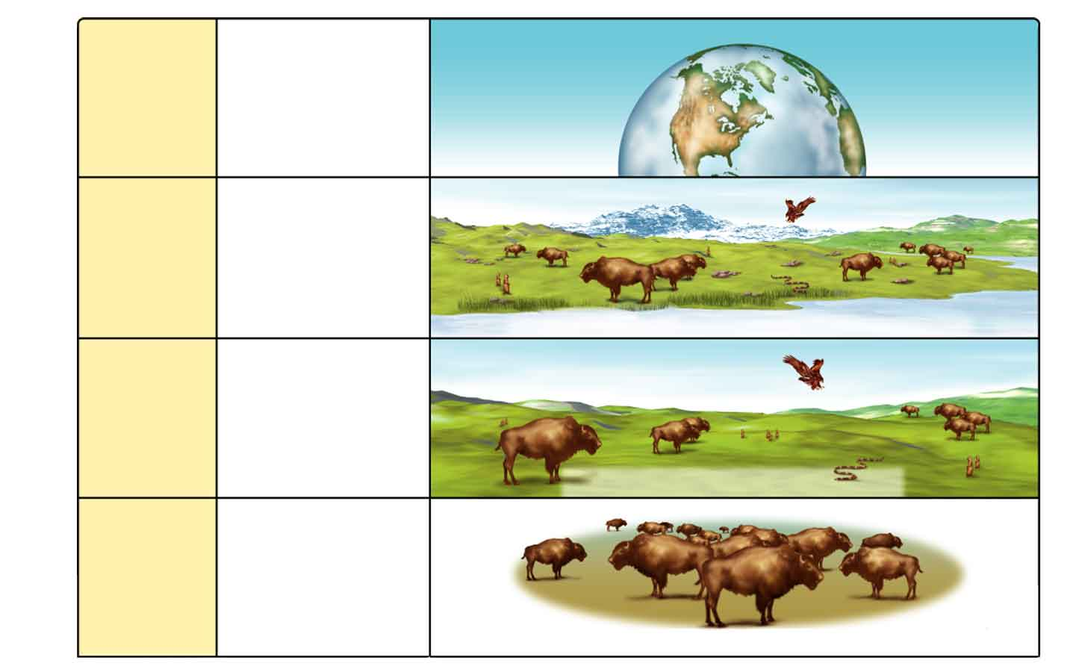
Figure 1-21 Levels of Organization
Section 1-3
Biosphere
The part of Earth
that contains all
ecosystems
Biosphere
Ecosystem
Community and
its nonliving
surroundings
Hawk, snake, bison, prairie dog, grass, stream, rocks, air
Community
Populations that
live together in a
defined area
Hawk, snake, bison, prairie dog, grass
Population
Group of
organisms of one
type that live in
the same area
Bison herd

Slide 7
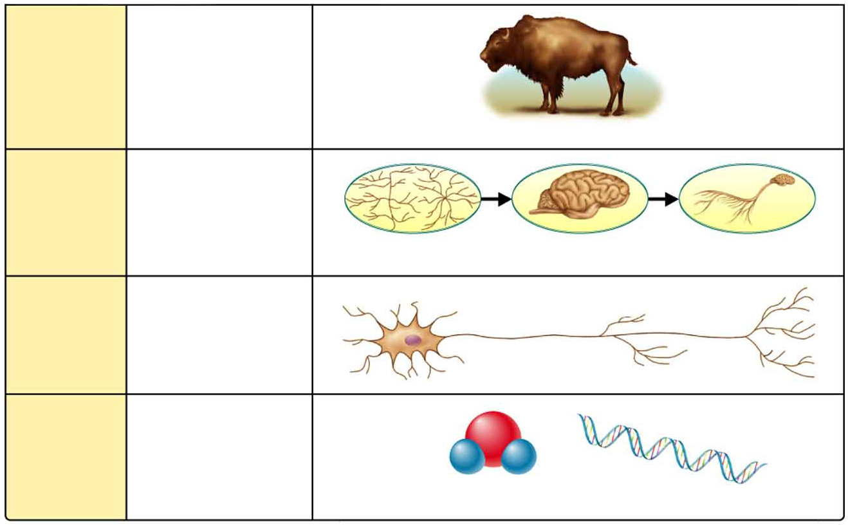
Figure 1-21 Levels of Organization continued
Section 1-3
Organism
Individual living
thing
Bison
Groups of
Cells
Tissues, organs,
and organ systems
Nervous tissue
Brain
Nervous system
Smallest functional
unit of life
Cells
Nerve cell
Groups of atoms;
smallest unit of
most chemical
compounds
Molecules
Water
DNA

Slide 8
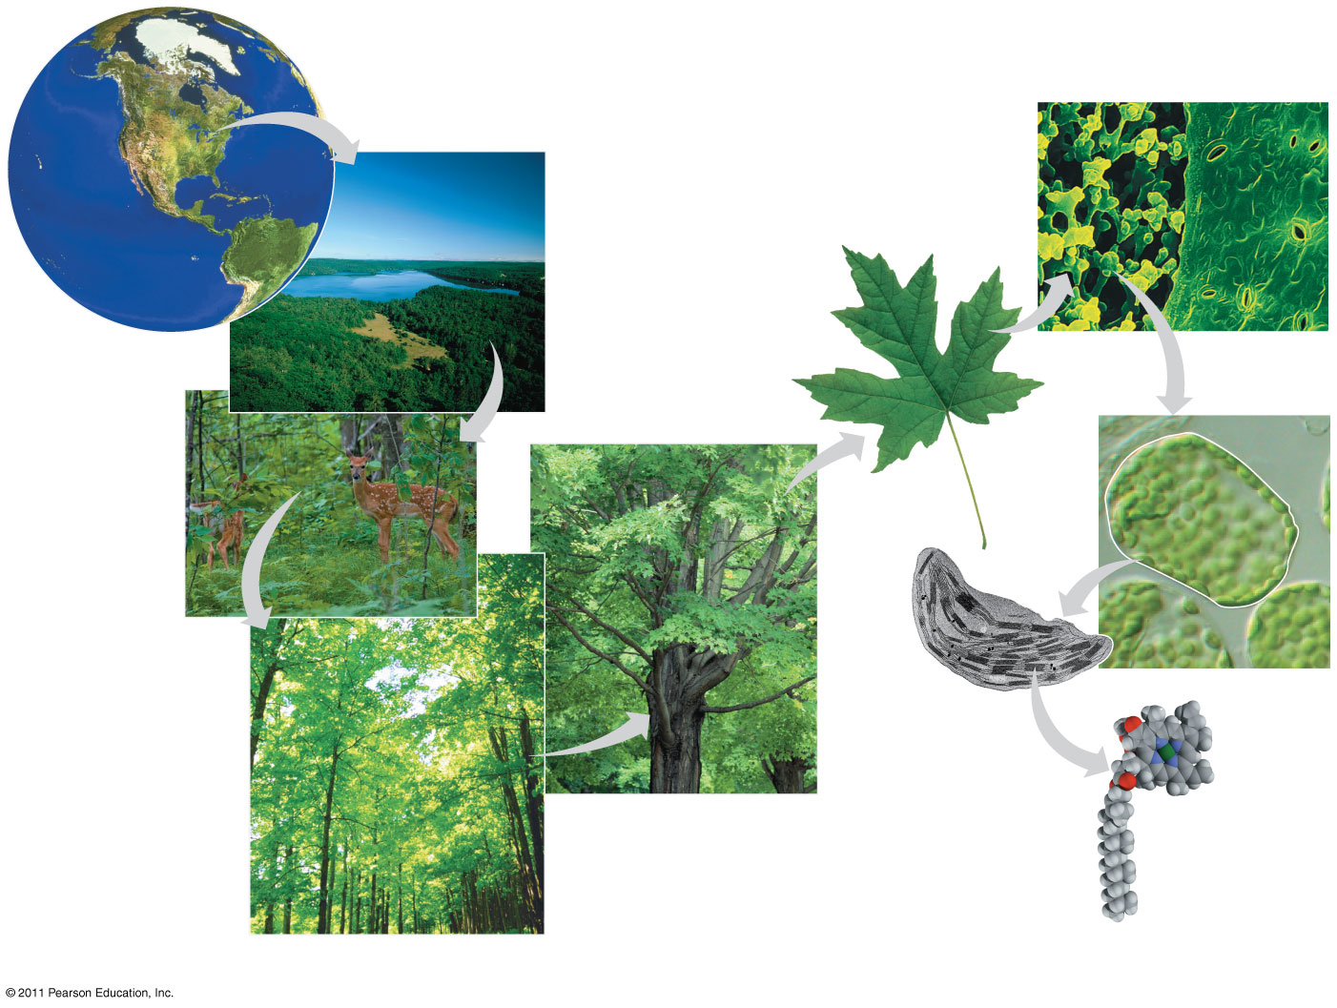
Figure 1.4
The biosphere
Tissues
Ecosystems
Organs and
organ systems
Communities
Cells
Organelles
Organisms
Atoms
Populations
Molecules
Notes:
Figure 1.4 Exploring: Levels of Biological Organization

Slide 9
Characteristics of Life
Living things are made up of units called cells.
Living things reproduce.
Living things are based on a universal genetic code
Living things grow and develop
Living things obtain and use materials and energy.
Living things respond to their environment
Living things maintain a stable internal environment.
Taken as a group, living things change over time.

Slide 10
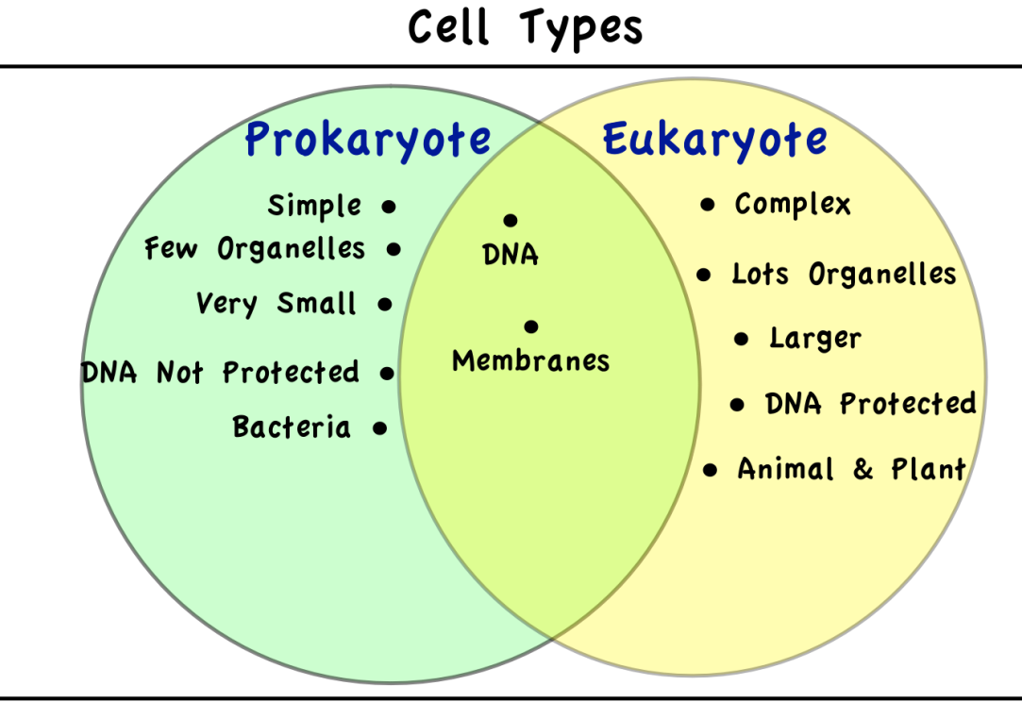
1. Living things are made up of units called cells.

Slide 11
2. Living things reproduce.

Slide 12
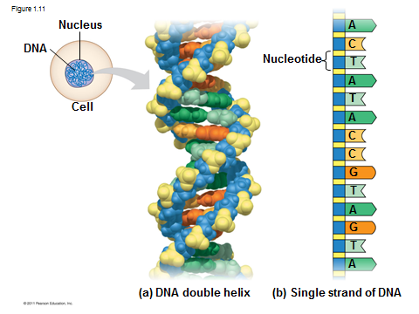
3. Living things are based on universal genetic code
Chromosomes contain most of a cell’s genetic material in the form of DNA (deoxyribonucleic acid)
DNA is the substance of genes
Genes are the units of inheritance that transmit information from parents to offspring

Slide 13
4. Living things grow and develop

Slide 14
5. Living things obtain and use materials and energy

Slide 15
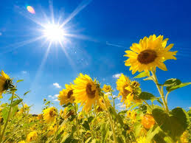
6. Living things respond to their environment

Slide 16
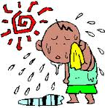
7. Living things maintain a stable internal environment. (Homeostasis) Ex: Regulation of body temperature

Slide 17
8. Taken as a group, living things change over time.

Slide 18
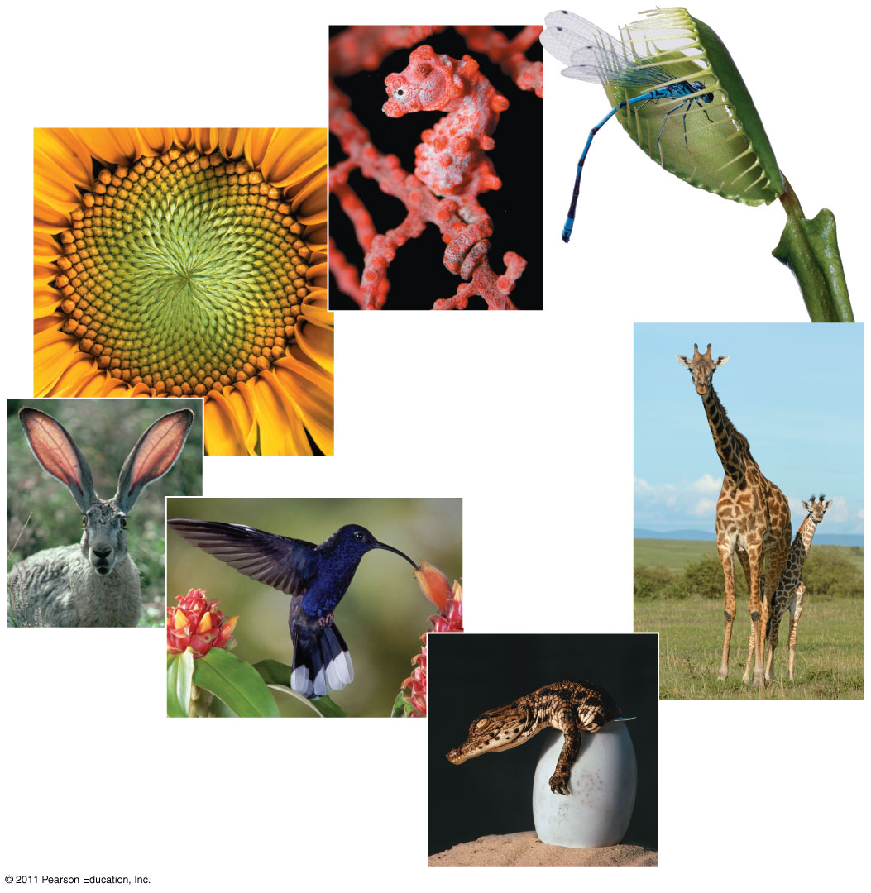
Figure 1.3
Order
Response to
the environment
Evolutionary adaptation
Reproduction
Regulation
Energy processing
Growth and
development
Notes:
Figure 1.3 Some properties of life.

Slide 19
Characteristics of Living Things
Section 1-3
Characteristic
Examples
Living things are made up of units called cells.
Many microorganisms consist of only a single cell. Animals and trees are multicellular.
Living things reproduce.
Maple trees reproduce sexually. A hydra can reproduce asexually by budding.
Living things are based on a universal genetic code.
Flies produce flies. Dogs produce dogs. Seeds from maple trees produce maple trees.
Living things grow and develop.
Flies begin life as eggs, then become maggots, and then become adult flies.
Living things obtain and use materials and energy.
Plants obtain their energy from sunlight. Animals obtain their energy from the food they eat.
Living things respond to their environment.
Leaves and stems of plants grow toward light.
Living things maintain a stable internal environment.
Despite changes in the temperature of the environment, a robin maintains a constant body temperature.
Taken as a group, living things change over time, or evolve.
Plants that live in the desert survive because they have become adapted to the conditions of the desert.

Slide 20
Bell Ringer: Is It Living?
Now revise your selection and reasoning
__x_ tree
___ rock (non-living)
___ fire(non-living)
__x_ boy
___ wind(non-living)
__x_ rabbit
___ cloud(non-living)
___ feather (non-living)
__x_ grass
__x_ seed
__x_ egg (Once living)
__x_ bacteria
__x_ cell
___ molecule
___ Sun (non-living)
__x_ mushroom
__x_ potato (parts of plant)
__x_ leaf(parts of plant)
__x_ butterfly
_x__ pupae (developmental stage)
__x_ fossil (depends, bones for ex. are once-living)
_x_ hibernating bear
___ mitochondria (No! it’s part of a cell)
___ river (non-living)

