Slide 1
Chapter 1
Lesson 2
Hypothesis, Theories, and Laws
Science, Technology, and Society

Slide 2
Hypothesis
In science, a true hypothesis is much more than just an educated guess.
They are predictions and descriptions that are based on scientific background knowledge, observations, logic, and prior experience.
You may be asked to form a simple hypothesis before performing a laboratory investigation. Keep in mind that this type of hypothesis is much simpler and less supported by data and observations than a hypothesis that would be published in the scientific community.

Slide 3
Theories
Scientific theories are broad explanations of the natural world that are based on strong scientific support.
A theory is more accepted by the scientific community when it is strongly supported by many different lines of evidence, but theories may be modified or overturned if warranted by new evidence or discoveries.
Theories are always changing.
However, theories never become laws.

Slide 4
Scientific Theories
The process through which a hypothesis is repeatedly tested by the scientific community is a lengthy one.
Most of the theories below were developed over decades.
If you wrote a testable hypothesis that described a new way that trees function, you would be on your way to contributing to a theory.
Others would examine your research and test your hypothesis. Your conclusions would be reviewed by your peers, and additional questions would be asked.
Eventually, many testable hypotheses might come together to form a theory. Theories are subject to revision and modification over time.

Slide 5
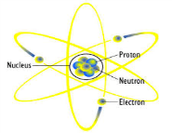
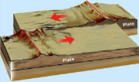
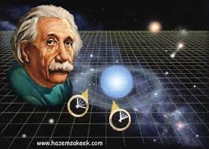
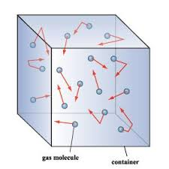
Examples of Scientific Theories
Atomic Theory: Matter is composed of atoms.
Theory of Plate Tectonics: The earth's crust consists of a number of movable yet semi-rigid plates.
Theory of Relativity: Time and space are relative concepts rather than absolute.
Kinetic Theory: Gases contain molecules that move randomly and constantly.

Slide 6
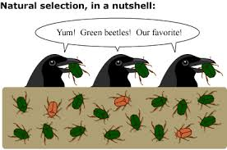
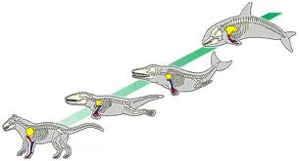
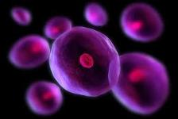
More examples….
Theory of Natural Selection: Organisms that have desirable traits pass on those traits to offspring.
Theory of Evolution: All living things change or adapt over time.
Cell Theory: Cells form the fundamental structures of all living things.

Slide 7
Laws
Scientific laws are descriptions of what we expect to happen in the natural world, based on many observations and data collected over time.
Laws differ from theories and hypotheses in that they only describe what happens in the natural world and do not attempt to explain why it happens.

Slide 8
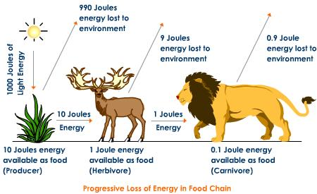
Examples of Laws
1st Law of Thermodynamics: In ordinary physical and chemical changes, energy cannot be created or destroyed, only transformed.
2nd Law of Thermodynamic: All energy transformations are NOT a 100% efficient.

Slide 9
Misconception Alert
Many people believe that if evidence supports a hypothesis, it is upgraded to a theory. If the theory then gains even more support, it may be upgraded to a law.
This is incorrect! Hypotheses, theories, and laws are like apples, oranges, and pineapples in that one will never be able to grow into another, no matter how much fertilizer and water are offered. Hypotheses, theories, and laws are all scientific explanations that differ in breadth, not in level of support.

Slide 10
This attempts to explain something about the natural world.
Scientific theory
Scientific law
Both scientific theory and scientific law

Slide 11
This describes specific details about what happens in nature, without attempting to explain why it happens.
Scientific theory
Scientific law
Both scientific theory and scientific law

Slide 12
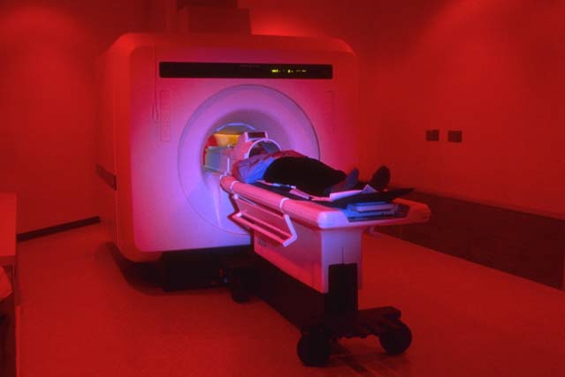
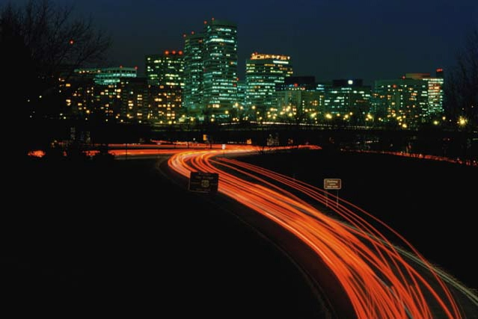
Science, Technology and Society
Science and technology have had both a positive and negative impact on society, especially in the following areas:
Health
Community Life
Communication
Work

Slide 13
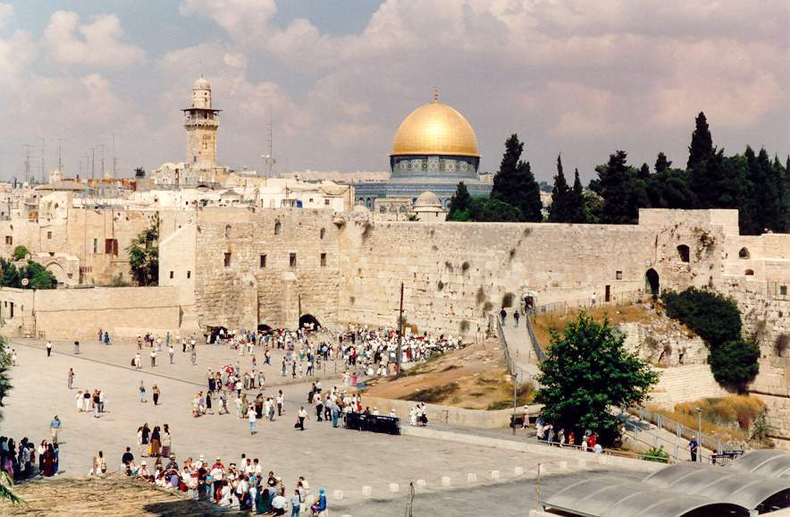
Community Life
The shift from nomadic life to farming led to the development of the city.
Networks of transportation, communication, and trade systems
Specialized labor
Government and religion
Social class
Jerusalem, one of the world’s first cities, is still in existence today.
Copyright © 2006 by the McGraw-Hill Companies, Inc.

Slide 14
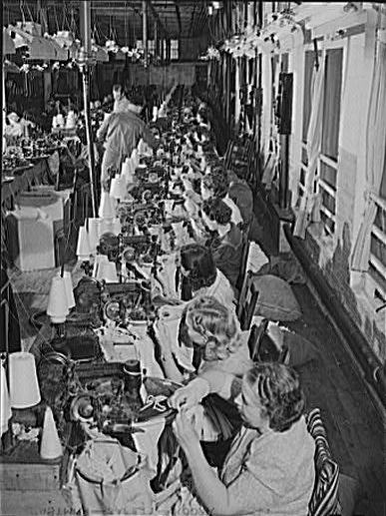
Community Life
(Continued)
The nineteenth century witnessed the Industrial Revolution.
Invention of textile manufacturing machines
Division of labor
Increase in production
Crowded cities
Unsafe and unhealthy working conditions
Some of the negative aspects of the Industrial Revolution included poor working conditions and long hours.
Copyright © 2006 by the McGraw-Hill Companies, Inc.

Slide 15
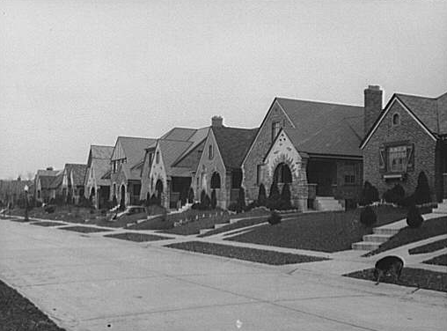
Community Life
(Continued)
The twentieth century saw the birth of suburbs.
Invention of the trolley car and automobile
Status symbol
Alternative to harsh, crowded city conditions
Many planned communities, such as this one outside Cincinnati, OH, sprang up around cities during the first half of the twentieth century.
Copyright © 2006 by the McGraw-Hill Companies, Inc.

Slide 16
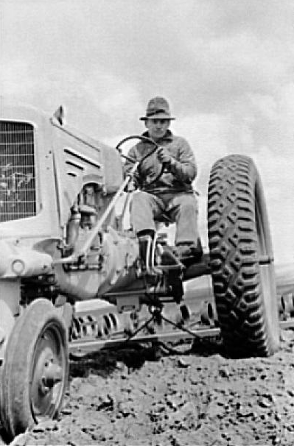
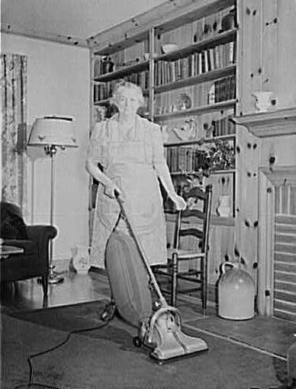
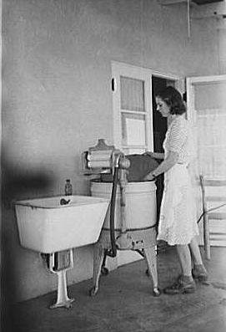
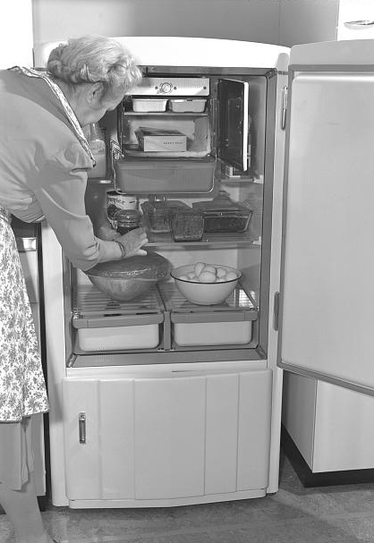
Work
Technical innovations saved physical energy and lessened people’s workload.
The tractor
The vacuum cleaner
The washing machine
The refrigerator
Copyright © 2006 by the McGraw-Hill Companies, Inc.

Slide 17
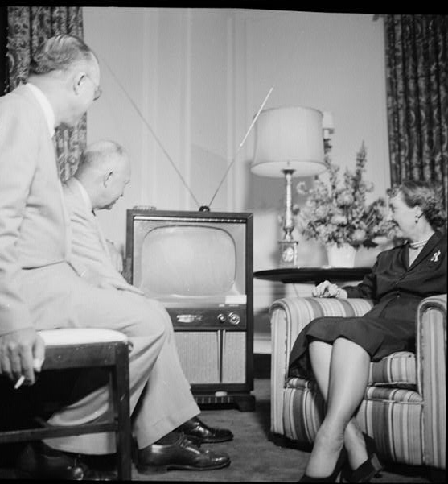
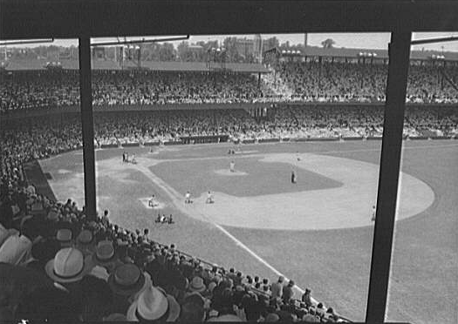
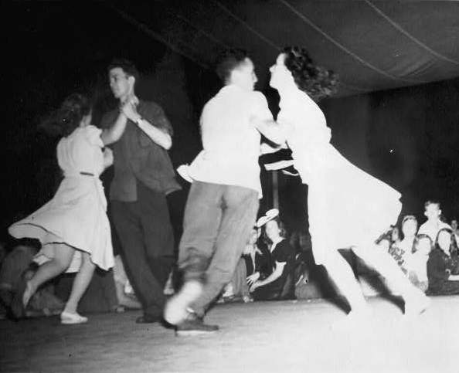
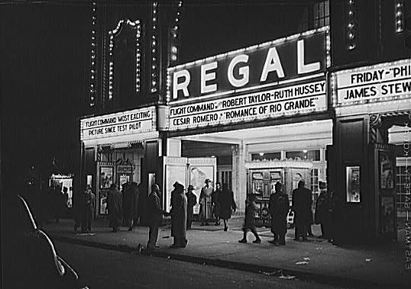
Work
(Continued)
The concept of leisure developed from labor-saving technology. People use the money they earn to take advantage of leisure time.
Sporting Events
Television
Movies
Social Activities
Copyright © 2006 by the McGraw-Hill Companies, Inc.

Slide 18
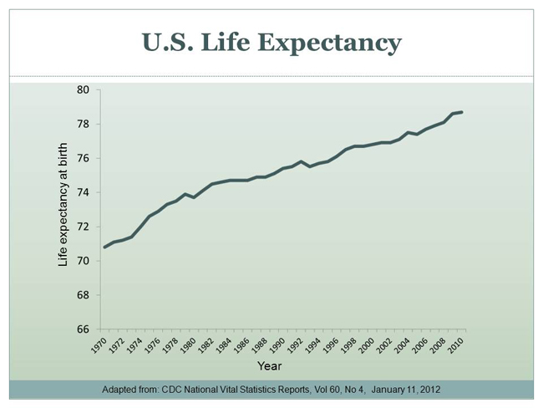
The greatest innovation of technology was longevity.
Health

Slide 19
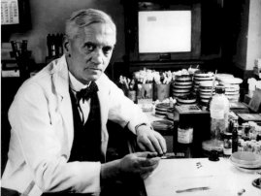
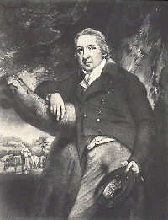
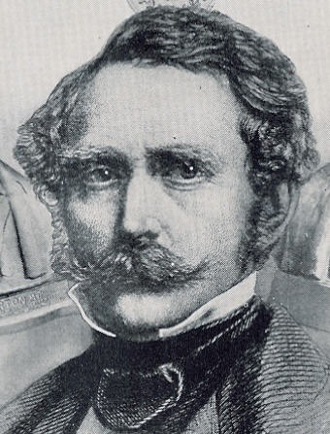
Health
(Continued)
A large part of technology has been dedicated to the advancement of medical science.
Sir Alexander Fleming discovered penicillin, the first antibiotic, in 1928.
In 1796, Edward Jenner paved the way for modern immunology by discovering a vaccine for smallpox.
Dr. William Thomas Green Morton (c. 1846) was one of the first medical practitioners to use anesthesia on a patient before performing surgery.
Copyright © 2006 by the McGraw-Hill Companies, Inc.

Slide 20
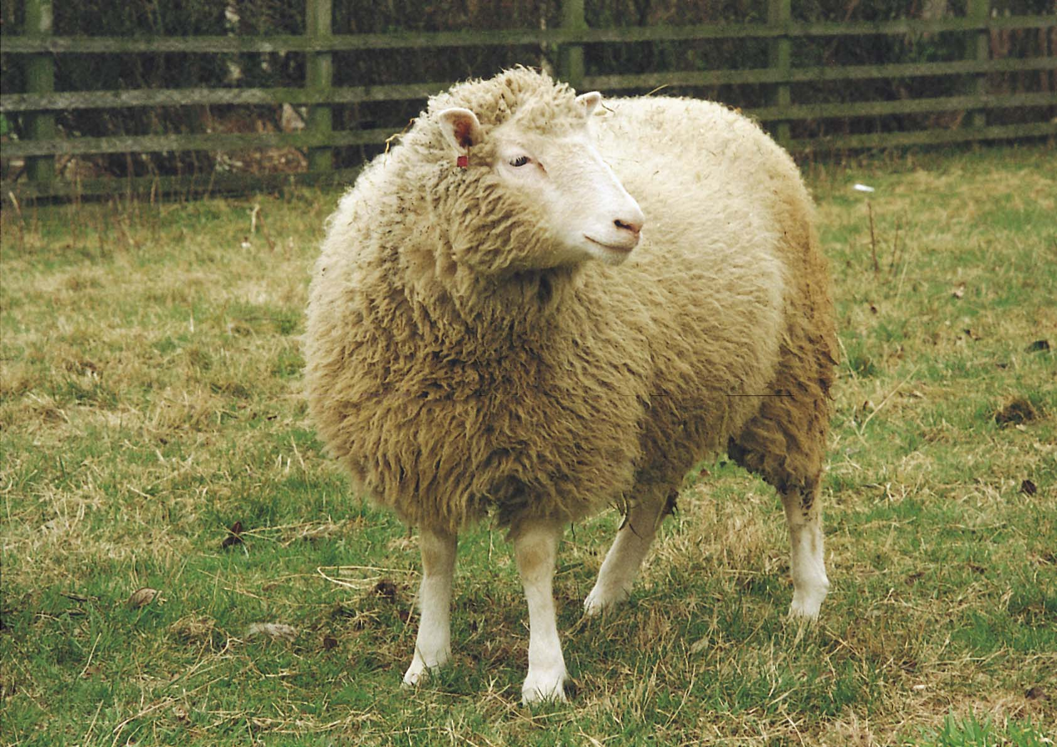
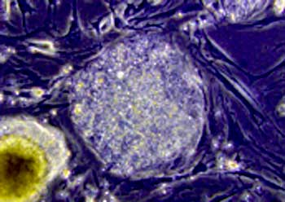
Health
(Continued)
Some current innovations could have a drastic impact on society.
In 1997, scientists at the Roslin Institute in Edinburgh, Scotland, introduced Dolly the sheep, the first mammal ever to have been cloned. Dolly quickly became the symbol of the controversy over the ethics of cloning.
Embryonic stem cell research is another area that is at the center of controversy. While stem cells might be able to be used to generate new organs for transplant, the use of them has many ethical considerations.
Copyright © 2006 by the McGraw-Hill Companies, Inc.

Slide 21
Communication
Inventions and innovations in communication have had a major influence on society.
Egypt: papyrus and hieroglyphics
Ancient Babylonia: cuneiform
Ancient Greece: public speaking, persuasive rhetoric, drama, and philosophy
Ancient Rome: Roman alphabet
Modern Europe: printing press
World today: World Wide Web
Copyright © 2006 by the McGraw-Hill Companies, Inc.

Slide 22
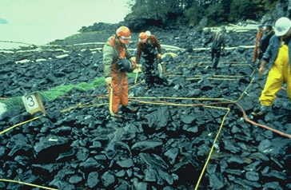
Progress
Progress is a series of improvements in human life marked by inventions and discoveries.
Positive attributes of technology must be greater than negative attributes
Negative consequences: destruction of environment and loss of what it means to be human
The Exxon Valdez oil spill off the coast of Alaska in 1989 impacted 1,300 miles of shoreline and killed an enormous amount of wildlife.
Copyright © 2006 by the McGraw-Hill Companies, Inc.

Slide 23
What is the role of science in society?
Science adds to society’s body of knowledge
Scientific knowledge leads to new, practical technologies.
Understanding science helps people solve everyday problems.
Science must take societal issues into account. Many questions can NOT be answered by science alone and need input from society.

