Slide 1
Darwin’s Theory of Evolution by Means of Natural Selection
By Dr. J. Suris Soto
SC.912.L.15.13

Slide 2
Lesson Objectives
By the end of this lesson you should be able to
Summarize the main points of Darwin’s theory.
Summarize the major concepts of natural selection
Explain how natural selection acts as a mechanism of evolution.

Slide 3
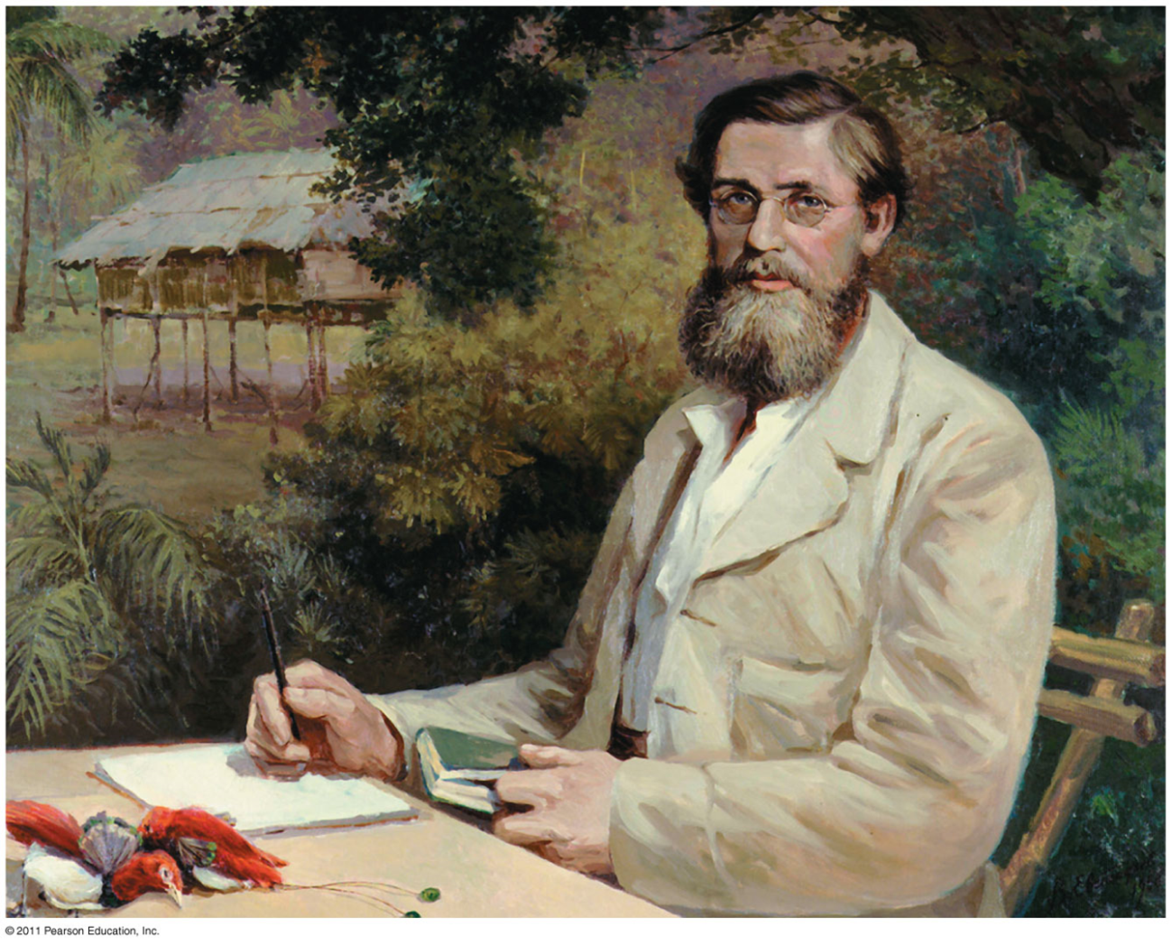
Darwin Introduces a Revolutionary Theory
A new era of biology began on November 24, 1859
The day Charles Darwin published On the Origin of Species by Means of Natural Selection

Slide 4
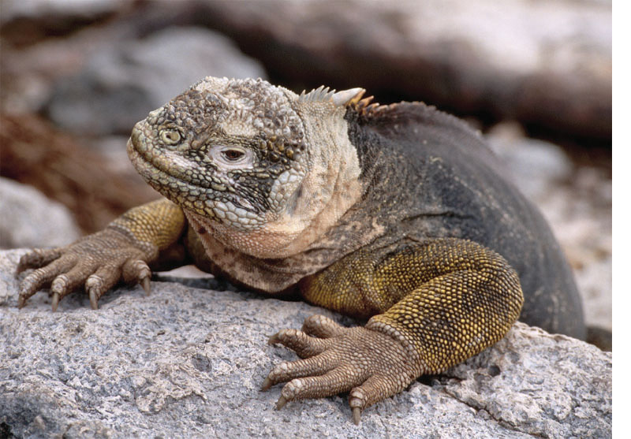
The Origin of Species
Focused biologists’ attention on the great diversity of organisms

Slide 5
The Origin of Species
Darwin made two major points in his book
He presented evidence that the many species of organisms presently inhabiting the Earth are descendants of ancestral species
He proposed a mechanism for the evolutionary process, natural selection

Slide 6
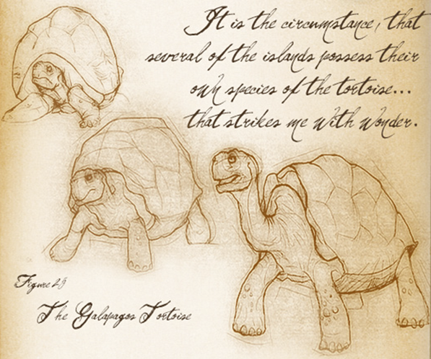
Darwin and the HMS Beagle
In 1831, Darwin set sail on the HMS Beagle to chart the coast of South America.
He collected many biological and geological specimens to bring back to London for further study.
He kept detailed journals with exquisite drawings, and many notes about the data collected.

Slide 7
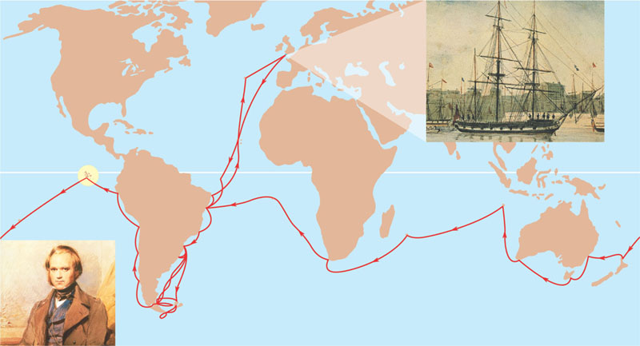
Darwin’s interest in the geographic distribution of species
Was ignited by the Beagle’s stop at the Galápagos Islands.
England
EUROPE
NORTH
AMERICA
PACIFIC
OCEAN
ATLANTIC
OCEAN
Galápagos
Islands
AFRICA
HMS Beagle in port
Darwin in 1840,
after his return
SOUTH
AMERICA
AUSTRALIA
Andes
Cape of
Good Hope
Cape Horn
Tasmania
New
Zealand
Tierra del Fuego

Slide 8
Darwin’s Focus on Adaptation
As Darwin reviewed everything that he had observed during the voyage of the Beagle
He began to perceive adaptation to the environment and the origin of new species as closely related processes

Slide 9
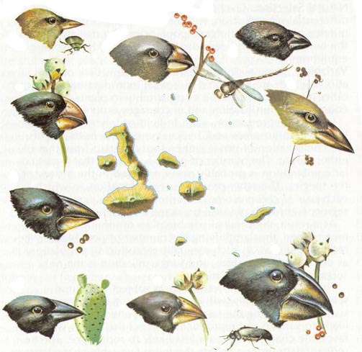
The Galapagos Islands
Darwin took interest in the Galapagos finches
He noticed that there were many different types of species of finches occupying different niches.
Their beaks were adapted to the food found in such niches.
The Galapagos finches were different, but similar to those in mainland.

Slide 10
Descend with Modification
Darwin studied the breeding of pigeons with distinctive traits, and the selection of colorful feathers or largest tails
Darwin wondered if a similar process could occur in nature in response to environmental pressures and create new species over time.
Darwin hypothesized that new species could appear gradually through small changes in ancestral species.

Slide 11
Artificial Selection, Natural Selection, and Adaptation
Darwin noted that humans have modified other species by selecting and breeding individuals with desired traits, a process called artificial selection
Darwin drew two inferences from two observations

Slide 12
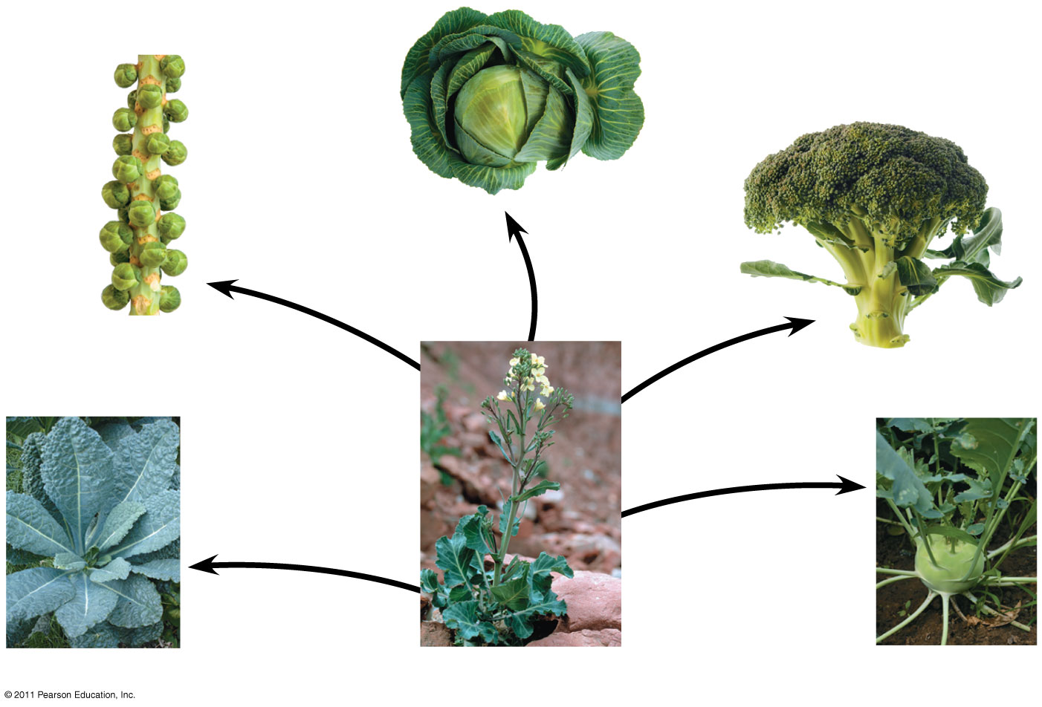
Cabbage
Selection for apical (tip) bud
Brussels
sprouts
Selection for axillary (side) buds
Broccoli
Selection for flowers and stems
Selection for stems
Selection for leaves
Kale
Wild mustard
Kohlrabi
Notes:
Figure 22.9 Artificial selection.

Slide 13
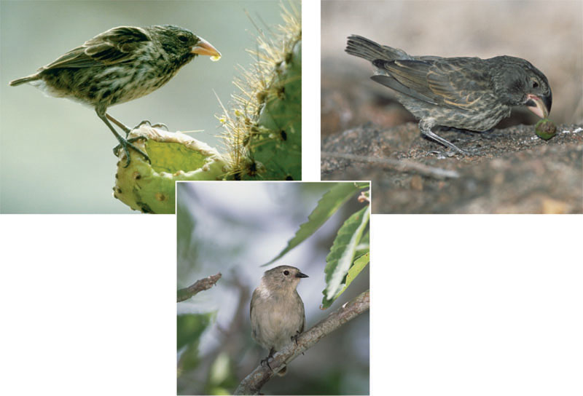
Descend with modifications
From studies made years after Darwin’s voyage
Biologists have concluded that this is indeed what happened to the Galápagos finches
(a) Cactus eater. The long, sharp beak of the cactus ground finch (Geospiza scandens) helps it tear and eat cactus flowers and pulp.
(c) Seed eater. The large ground finch (Geospiza magnirostris) has a large beak adapted for cracking seeds that fall from plants to the ground.
(b) Insect eater. The green warbler finch (Certhidea olivacea) uses its narrow, pointed beak to grasp insects.

Slide 14
Descent with Modification
The phrase descent with modification
Summarized Darwin’s perception of the unity of life
States that all organisms are related through descent from a common ancestor that lived in the remote past

Slide 15
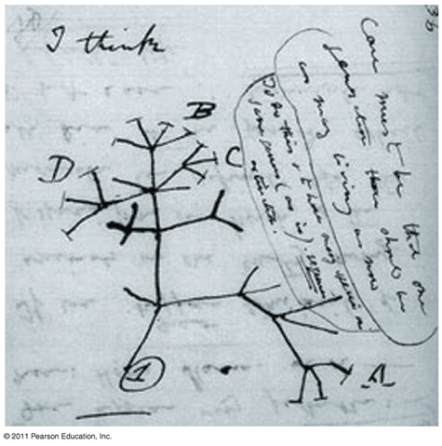
Descent with Modification
In the Darwinian view, the history of life is like a tree with branches representing life’s diversity
Darwin’s theory meshed well with the hierarchy of Linnaeus (father of taxonomy = classification)

Slide 16
Observation #1: Members of a population often vary in their inherited traits

Slide 17
Observation #2: All species can produce more offspring than the environment can support, and many of these offspring fail to survive and reproduce
Overproduction of offspring

Slide 18
Inference #1: Individuals whose inherited traits give them a higher probability of surviving and reproducing in a given environment tend to leave more offspring than other individuals
Inference #2: This unequal ability of individuals to survive and reproduce will lead to the accumulation of favorable traits in the population over generations

Slide 19
Darwin was influenced by Thomas Malthus, who noted the potential for human population to increase faster than food supplies and other resources
If some heritable traits are advantageous, these will accumulate in a population over time, and this will increase the frequency of individuals with these traits
This process explains the match between organisms and their environment

Slide 20
The Origin of Species by means of Natural Selection
Darwin explained three broad observations:
The unity of life
The diversity of life
The match between organisms and their environment

Slide 21
The Origin of Species by means of Natural Selection
In 1844, Darwin wrote a long essay on the origin of species and natural selection
But he was reluctant to introduce his theory publicly, anticipating the uproar it would cause
In June 1858 Darwin received a manuscript from Alfred Russell Wallace
Who had developed a theory of natural selection similar to Darwin’s
Darwin quickly finished The Origin of Species
And published it the next year

Slide 22
Darwin’s Main Points
Some competitors will be better adapted or equipped for survival than others.
The best-equipped organisms will survive.
Over time, beneficial variations will be passed down from generation to generation, gradually changing the population as a whole.
Organisms within a population compete for resources to survive

Slide 23
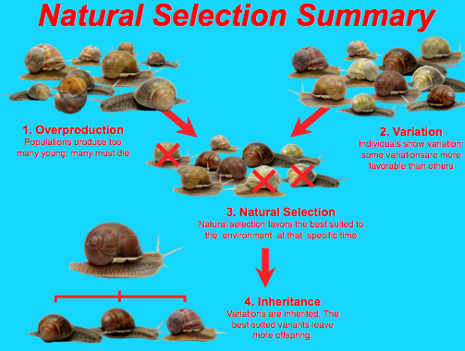

Slide 24
Adaptations
Variations that provide a competitive advantage to an organism to survive, thus increasing the reproductive success .
Structural/ functional
The physical or functional features of an organisms that helps them survive.
Behavioral
The things organisms do to survive

Slide 25
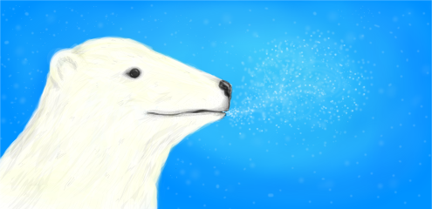
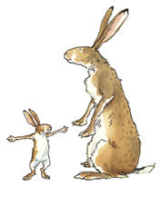
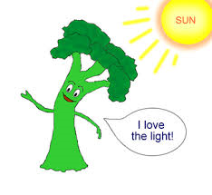
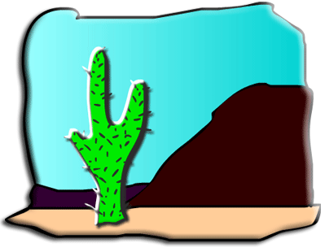
Structural or Functional
Behavioral
Thick fur on a polar bear to keep it warm.
Rabbits have large ears to hear and avoid danger.
Cactus have long roots to get more water in the desert
Birds migrate to find food.
Plants grow towards the light to capture more sunlight.
Opossums play
dead to confuse predators.

Slide 26
What Is Theoretical about the Darwinian View of Life?
In science, a theory
Accounts for many observations and data and attempts to explain and integrate a great variety of phenomena

Slide 27
Natural Selection: A Summary
Individuals with certain heritable characteristics survive and reproduce at a higher rate than other individuals
Natural selection increases the adaptation of organisms to their environment over time
If an environment changes over time, natural selection may result in adaptation to these new conditions and may give rise to new species

Slide 28
Darwin’s theory of evolution by natural selection
Integrates diverse areas of biological study and stimulates many new research questions

