Slide 1
Dna replication

Slide 2
SC.L.16.3 Describe the basic process
of DNA replication and how it relates
to the transmission and conservation
of the genetic information

Slide 3
DNA and Its structure
DNA (deoxyribonucleic acid) is a large organic
molecule found in a cell’s nucleus.
The information in DNA directs how proteins will
be assembled. The proteins then regulate the
cell’s activities.
DNA is a nucleic acid made up of smaller
molecules called nucleotides. A nucleotide consists
of a phosphate, the sugar deoxyribose and a
nitrogenous base.
There are four nitrogenous bases:
adenine(A), thymine (T), guanine (G), and cytosine (C)

Slide 4
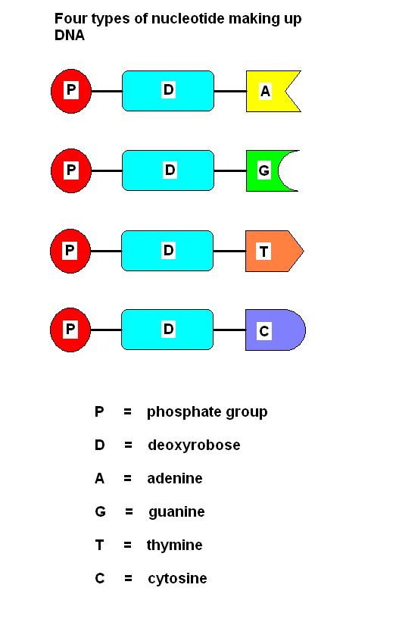

Slide 5
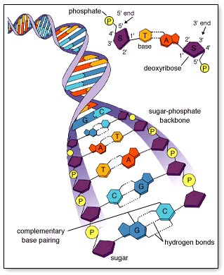
The nucleotides in DNA form long chains. Two chains linked
and twisted like a spiral staircase. This shape is called a
double helix. Adenine pairs only with thymine, and cytosine
pairs only with guanine. The strands are complementary to
Each other.

Slide 6
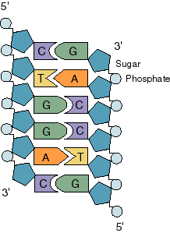
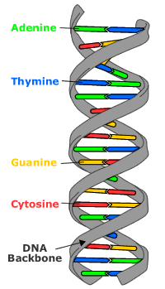
DNA structure

Slide 7
DNA replication
Before a cell divides , it duplicates its DNA. When a
cell divides identical copies of its DNA are
passed along to each new daughter cell. The
copying of DNA is called DNA replication
During DNA replication
1. The strands of DNA separate.
2. New nucleotides bond to each strand.
3. Two DNA molecules are formed

Slide 8
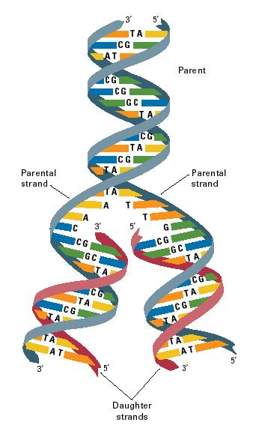

Slide 10
DNA Animation
DNA replication begins at specific point in the DNA molecule called
the origin of replication site.
The enzyme HELICASE unwinds, and separates a portion of the DNA molecule
Single strand binding proteins react with and stabilize the separated,
single stranded sections of the DNA molecule.
An enzyme called primase assembles an RNA primer at the origin of
Replication site. The RNA primer consists of a short sequence of
nucleotides complementary to a small, initial section of DNA strand
being prepared for replication.
DNA polymerase adds DNA nucleotides to the RNA primer and thus begin the process of constructing a new complementary strand of DNA.
Later the RNA primer is enzymatic ally removed and replaced with an appropriate sequence of DNA nucleotides.
Because the two complementary strands of the DNA molecule are oriented in opposite direction, and the DNA polymerase can accommodate replication in only one direction, two different mechanisms for copying the strands of DNA are employed.

Slide 11
One strand is replicated continuously towards the unwinding, separating portion of the original DNA molecule; while the other strand is replicated discontinuously in the opposite direction with the formation of a series of short DNA segments called Okazaki fragments. Each Okazaki fragment requires a separate RNA primer.
As the Okazaki fragments are synthesized, the RNA primer is enzymatic ally removed and replaced with the appropriate sequences o DNA nucleotides.
The individual Okazaki fragments are then bonded together into a continuous complementary strand by a DNA ligase, which seals the gaps between the segments.
DNA replication results in two identical daughter molecules each consisting of one old (original) strand and one newly-synthesized strand.
SUMMARY
Separation by Helicase
RNA primer binds to template
DNA polymerase brings DNA nucleotides
DNA ligase seals the gaps between the Okazaki fragments.

Slide 12
universal code
The genetic code is nearly universal because all organisms:
1. encode their genes using DNA or RNA.
2. use the same codon for the same amino acid.
3. are genetically related to all other organisms.

Slide 13
Difference between the DNA of prokaryotes and the DNA of eukaryotes
Prokaryotic DNA is shorter and less complex than eukaryotic DNA.
Prokaryotic DNA has single chromosomes; eukaryotic DNA has multiple chromosomes.
Prokaryotic DNA is arranged in circular structures; eukaryotic DNA consists of linear strands

Slide 14
Difference between DNA transcription and DNA replication
DNA replication results in two copies of a double helix of DNA, while DNA transcription results in a single-stranded RNA molecule

Slide 15
Difference between transcription and translation
In transcription, the genetic code of a DNA molecule is transferred to a messenger RNA molecule.
Translation is the process of creating an amino acid chain using the encoded messenger RNA.

Slide 16
mutations
DNA mutation is a change in the gene sequence,
which sometimes results in phenotypic change.
Mutations can be due to
environmental factors,
heredity,
or a mistake in DNA replication.

