Slide 1
Fingerprints

Slide 2
Chapter 6 Fingerprints By the end of this chapter you will be able to:
discuss the history of fingerprinting
describe the characteristics of fingerprints and fingerprinting minutiae
explain when and how fingerprints are formed
describe what causes fingerprints to be left on objects
identify the basic types of fingerprints
describe how criminals attempt to alter their fingerprints
All Rights Reserved South-Western / Cengage Learning © 2009

Slide 3
Chapter 6 Fingerprints By the end of this chapter you will be able to:
determine the reliability of fingerprints as a means of identification
describe the Integrated Automated Fingerprint Identification System (IFAIS)
explain how fingerprint evidence is collected
describe the latest identification technologies
determine if a fingerprint matches a fingerprint on record
use the process of lifting a latent print

Slide 4
Historical Development
The oldest known documents showing fingerprints date from third century B.C. China.
In ancient Babylon (dating back to 1792-1750 B.C.), fingerprints pressed into clay tablets marked contracts.
The earliest written study (1684) is Dr. Nehemiah’s paper describing the patterns he saw on human hands under a microscope, including the presence of ridges.
In 1788, Johann Mayer noted that the arrangement of skin ridges is never duplicated in two persons. He was probably the first scientist to recognize this fact.

Slide 5
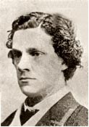
Historical Development
5. Nine fingerprint patterns were described in 1823 by Jan Evangelist Purkyn.
6. Sir William Herschel (shown at the right), in 1856, began the collection of fingerprints and noted they were not altered by age.
7. Alphonse Bertillon created a way to identify criminals that was used in 1883 to identify a repeat offender.
8. In 1888, Sir Francis Galton (shown at the right), and Sir Edmund Richard Henry, developed the fingerprint classification system that is still in use in the United States.

Slide 6
Historical Development
9. In 1891, Iván (Juan) Vucetich improved fingerprint collection. He began to note measurements on identification cards, as well as adding all ten fingerprint impressions. He also invented a better way of collecting the impressions.
10. Beginning in 1896, Sir Henry (mentioned in the last entry on the previous slide), with the help of two colleagues, created a system that divided fingerprints into groups. Along with notations about individual characteristics, all ten fingerprints were imprinted on a card (called a ten card).

Slide 7
What Are Fingerprints?
All fingers, toes, feet, and palms are covered in small ridges.
These ridges are arranged in connected units called dermal, or friction, ridges.
These ridges help us get or keep our grip on objects.
Natural secretions plus dirt on these surfaces leave behind an impression (a print) on those objects with which we come in contact.

Slide 8
Formation of Fingerprints
An animal’s external tissue (skin) consists of (a) an inner dermis and (b) an outer epidermis.
The creation of fingerprints occurs in a special layer (the basal layer) in the epidermis where new skin cells are produced.
Fingerprints probably begin forming at the start of the 10th week of pregnancy.
Because the basal layer grows faster than the others, it collapses, forming intricate shapes.

Slide 9
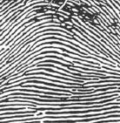
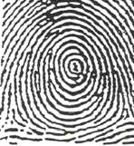
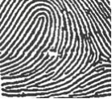
Characteristics of Fingerprints
There are 3 general fingerprint distinctions:
ARCH WHORL LOOP
About 5% ut 30% About 65% of the population

Slide 10
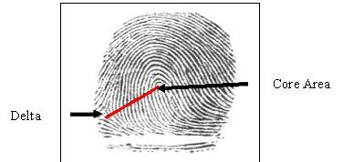
Characteristics of Fingerprints
Forensic examiners look for the presence of a core (the center of a whorl or loop) and deltas (triangular regions near a loop).
A ridge count is another characteristic that distinguishes one fingerprint from another. The count is made from the center of the core to the edge of the delta.

Slide 11
Characteristics of Fingerprints
Basic patterns can be further divided:
Arch patterns can be plain (4%) or tented (1%).
Whorl patterns can be central pocket (2%), double loop (4%), or accidental (0.01%).
Even twins have unique fingerprints due to small differences (called minutiae) in the ridge patterns.

Slide 12
Types of Fingerprints
There are 3 types of prints that investigators look for at crime scenes:
Patent fingerprints are visible prints transferred onto smooth surfaces by blood or other liquids.
Plastic fingerprints are indentations left in soft materials such as clay or wax.
Latent fingerprints are not visible but made so by dusting with powders or the use of chemicals.

Slide 13
Fingerprint Forensic FAQs
Can fingerprints be erased?
No, if, for example, they are removed with chemicals, they will grow back.
Is fingerprint identification reliable?
Yes, but analysts can make mistakes.
Is fingerprint matching carried out by computers in a matter of seconds?
No, but the FBI’s Integrated Automated Fingerprint Identification System (IAFIS or AFIS) can provide a match in 2 hours for the prints in its Master File.

Slide 14
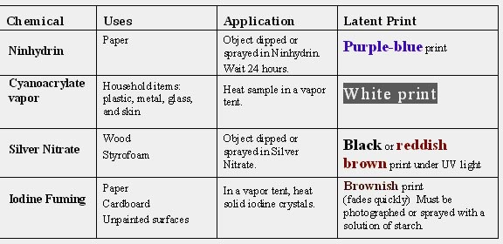
Fingerprint Forensic FAQs
How are latent fingerprints collected?

Slide 15
The Future of Fingerprinting
New scanning technologies and digitally identifying patterns may eliminate analytical mistakes.
Trace elements of objects that have been touched are being studied to help with the identification of individuals.
To help with identification, other physical features such as eyes and facial patterns are also being studied.

Slide 16
. . . . . . . . . . . . . . . . . Summary
Fingerprints have long been used for identification, and in the mid-1800s were recognized as unique to each person.
Three main groups include arches, whorls, and loops.
Basic analysis includes looking for cores, deltas, and making a ridge count.
Investigators search for patent, plastic, and latent prints.
Dusting with powders or using special chemicals can make latent fingerprints visible.
New developments may eliminate errors by analysts.

