Slide 1
Biological Macromolecules
SC.912.L.18.1-

Slide 2
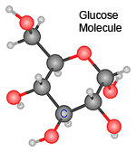
Carbohydrates
Building Blocks– what elements are carbohydrates made from :
Composed of carbon (C), hydrogen (H), and oxygen (O) in a 1:2:1 ratio
Functions: does “hydrate” remind you of water? H₂O?
Main source of QUICK energy for living things-- glucose, galactose, and fructose
Energy Storage– in animals glycogen is stored in the liver; in plants, starch is stored in the ROOTS
Structural– to build cell walls– cellulose, chitin
Examples:
Monosaccharides like glucose, galactose, and fructose
Polysaccharides like glycogen, starch, cellulose
Monomers are the building blocks for polymers
C₆H₁₂O₆
Notes:
The smaller units, or monomers, joins together to form polymers.

Slide 3
Lipids
Building Blocks:
Mostly made from carbon and hydrogen atoms, some oxygen
Functions and Examples:
Long-term Energy storage molecules—Fats
Cell Membranes– in EVERY organism– phospholipids
Water-proofing– earwax keeps water out and protects against infection; LIPIDS REPEL WATER!
Components:
A fat molecule consists of fatty acids joined to a molecule of glycerol
Phospholipids in cell membranes are made of a phosphate group and 2 fatty acid chains

Slide 4
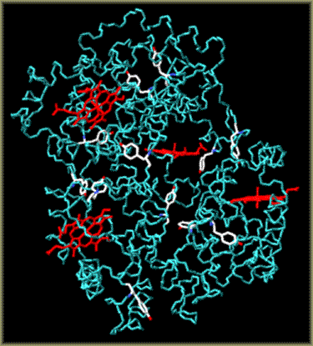
Proteins
Building Blocks:
Proteins contain carbon, hydrogen, oxygen and NITROGEN.
Functions and Examples:
Control the rate of reactions-- ENZYMES
Regulate cell processes--HORMONES
Form bones and muscles--COLLAGEN
Transport substances into or out of cells– PROTEINS IN THE CELL MEMBRANE
Help to fight disease-- ANTIBODIES
Components:
The monomer is the amino acid. Remember, the ribosome is where amino acids are assembled into PROTEINS.
VERY IMPORTANT FACT: The SHAPE of a protein is what allows it to do its job.
LOCK AND KEY– if the shape changes even slightly, the protein may not be able to do its job

Slide 5
Nucleic Acids
Building Blocks:
Contain carbon, hydrogen, oxygen, nitrogen, and PHOSPHORUS.
Function:
Nucleic acids store and transmit hereditary, or genetic, information.
Examples:
There are two types of nucleic acids: DNA and RNA.
Components:
The monomer is the nucleotide.
Nucleotides consist of three parts:
Phosphate group
Sugar (deoxyribose or ribose)
Nitrogenous base (C, G, A, T orU)

