Slide 1
SC.912.L.18.12 Properties of Water that contribute to Earth’s suitability as an environment for life: 1. Cohesive behavior. 2. Ability to moderate temperature. 3. Expansion upon freezing. 4. Versatility as a solvent

Slide 2
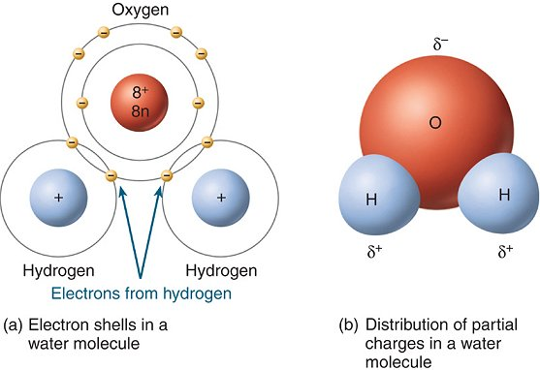
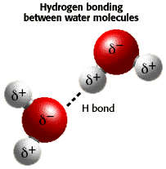
Nature of Water
Polar Molecule Hydrogen Bonds
Nature of Water
Physical properties of Water

Slide 3
Cohesion and Adhesion.
Cohesion is an attraction between substances of the same kind.
The hydrogen bonds between water molecules cause the cohesion
of liquid water. A water molecule attracts another water molecule
Because of cohesion, water and other liquids form thin films and
drops, and flows upward against the force of gravity through the
stem of a plant
Adhesion is an attraction between different substances. Water
Molecules are attracted to many other similarly polar substances.
Adhesion powers a process, called capillary action, in which water
molecules move upward through a narrow tube, such as the stem
of a plant.

Slide 4
Ability to Moderate Temperatures
Water absorbs heat more slowly and retains this
energy longer than many other substances do.
The ability of water to store heat longer than other
substances allow organisms to maintain a stable
internal temperature.
During daytime the oceans remove heat energy from
the atmosphere, at night the oceans release the heat.
Water plays an important role regulating temperatures
on Earth

Slide 5
Expansion Upon Freezing
Water expands and becomes less dense when it
Freezes (density of liquid water 1 g/ml, density of ice
0.94 g/ml)
Water is the most dense at 4 degrees Celsius.
Many fish and aquatic plants can survive a cold winter
because the layer of ice that forms at the top of a lake
insulates the water below and prevents the lake from
freezing solid.

Slide 6
Versatility as a Solvent
A solution is a mixture in which one or more substances
are evenly distributed in another substance.
The polarity of water enables many substances to
dissolve in water.
Ionic compounds and polar molecules dissolve best in
water.
Nonpolar molecules, however, do not dissolve well in
water.

Slide 7
1. A florist places a bouquet of white carnations in water containing blue dye. After a time, the flowers turn blue. What process helped the carnations to change color?
A. water’s ability to form crystals
B. ability of H2O to dissolve NaCl
C. cohesion and adhesion of water molecules
D. formation of covalent bonds between hydrogen and oxygen molecules

Slide 8
2. Which of these statements correctly explains why water is a good solvent for many ionic compounds?
F. Water is a polar compound.
G. Water is an ionic compound.
H. Water molecules are nonpolar.
I. Water molecules completely separate into ions in solution.

Slide 9
3. What is the attractive force between two of the same kind of particle?
A. adhesion
B. capillary action
C. cohesion
D. polarity

Slide 10
4. Which of the following is not a unique property of water?
F. Water molecules stick together by cohesion.
G. Frozen water is less dense than liquid water.
H. Water molecules stick to other polar substances.
I. Hydrogen bonds allow water to heat and cool very quickly.

Slide 11
5. Water has the ability to store heat longer than other substances. What benefit does
this property of water provide to organisms?
A. It provides the ability to dissolve nonpolar compounds.
B. It provides the appropriate catalyst for chemical reactions.
C. It enables organisms to function with a higher cellular pH.
D. It allows organisms to maintain a stable internal temperature.

Slide 12
6. Many fish and aquatic plants can survive a cold winter because the layer of ice that forms at the top of a lake insulates the water below and prevents the lake from freezing solid. What unique property of water contributes to this effect?
F. Water absorbs heat when it evaporates and forms a gas.
G. Water expands and becomes less dense when it freezes.
H. Water molecules completely separate into ions in solution.
I. Water forms hydrogen bonds with ions and other polar substances.

Slide 13
7. Water is essential for life. Its special properties make water the single most important molecule in plant life.
Which of the following properties of water enables it to move from the roots to the
leaves of plants?
A. Water expands as it freezes.
B. Water is an excellent solvent.
C. Water exhibits cohesive behavior.
D. Water is able to moderate temperatures.

