Slide 1
Structure and Function of macromolecules
SC.912.L.18.1 Describe the basic molecular structure and
primary function of the four macromolecules
Carbohydrates
Proteins
Lipids
Nucleic acids

Slide 2
MACROMOLECULES
Living things including cells, depend on a variety of biochemical processes for their survival.
Most biochemical processes that take place within cells make use of macromolecules (large molecules)
Large molecules that form when smaller compounds are joined together by chemicals bonds are known as macromolecules.

Slide 3
Kinds of macromolecules
Carbohydrates
Proteins
Lipids
Nucleic acids
All these macromolecules are organic compounds.(contain Carbon)
Organic compounds contain chemical bonds between carbon and hydrogen atoms.

Slide 4
Organic Compounds
Compounds that contain CARBON are called organic.
Macromolecules are large organic molecules.

Slide 5
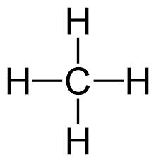
Carbon (C)
Carbon has 4 electrons in outer shell.
Carbon can form covalent bonds with as many as 4 other atoms (elements).
Usually with C, H, O, N, and P
Example: CH₄(methane)

Slide 6
Macromolecules
Large organic molecules.
Also called POLYMERS.
Made up of smaller “building blocks” called MONOMERS.
Examples:
1. Carbohydrates
2. Lipids
3. Proteins
4. Nucleic acids (DNA and RNA)

Slide 7
How Are Macromolecules Formed?
Question:

Slide 8
Answer: Dehydration Synthesis
Forms polymers by combining monomers by “removing water”.
HO
H
HO
H
H₂O
HO
H

Slide 9
Question:
How are Macromolecules separated or digested?

Slide 10
Answer: Hydrolysis
Separates monomers by “adding water”
HO
H
H₂O
HO
H
HO
H

Slide 11
Carbohydrates
A carbohydrate is a biomolecule consisting of carbon, hydrogen and oxygen atoms, usually with a carbon-hydrogen–oxygen atom ratio of 1:2:1. ​ Carbohydrates can be classified based on the amount of monomer units present as monosaccharides, disaccharides, and polysaccharides
Saccharide means “sugar”

Slide 12
Carbohydrates
Monosaccharide: one sugar unit
Examples: glucose (C₆H₁₂O₆)
Fructose
Galactose
glucose

Slide 13
Carbohydrates
Disaccharide: two sugar unit
Examples:
Sucrose (glucose+fructose)
Lactose (glucose+galactose)
Maltose (glucose+glucose)
glucose
glucose

Slide 14
Carbohydrates
Polysaccharide: many sugar units
Examples: starch (bread, potatoes)
glycogen (found in liver and muscle)
cellulose (lettuce, corn)
glucose
glucose
glucose
glucose
cellulose
glucose
glucose
glucose
glucose

Slide 15
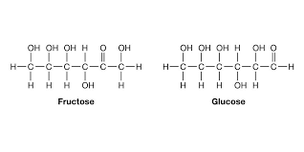
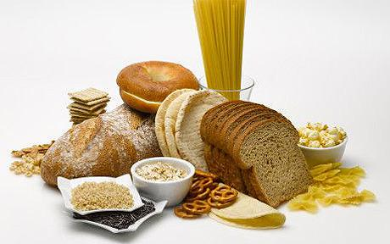
CARBOHYDRATES
Molecular Structure
Carbon
Hydrogen
Oxygen
Ratio 1:2:1
C6H12O6
Glucose (Monosaccharide)
Sucrose (Disaccharide)
Starch (Polysaccharide)
Function
Primary energy source of most organisms (energy for
cellular respiration)
Structural support to organisms. For example, cellulose in plant’s cell walls.

Slide 16
Each carbohydrate molecule contains many carbon
bonds.
Organisms get energy by breaking these
Bonds.
Carbohydrates provide QUICK Energy, but
the energy is USED UP QUICKLY (short-term energy)

Slide 17
Summary of carbohydrates
Macromolecule | Monomer | Composition | Function
Carbohydrates | Monosaccharide | Carbon Hydrogen Oxygen (form sugars) C:H:O 1:2:1 ratio | Main source of energy for cells Short term energy storage Structural support: cellulose in plant cell’s walls

Slide 18
Lipids
Organic compounds composed of Carbon, Hydrogen and Oxygen (CHO)
General term for compounds which are not soluble in water.HYDROPHOBIC
Remember: “stores the most energy”
Use for long -term energy storage
Examples: - Fats & Oils
-Phospholipids
- Steroids (like cholesterol)
-Waxes

Slide 19
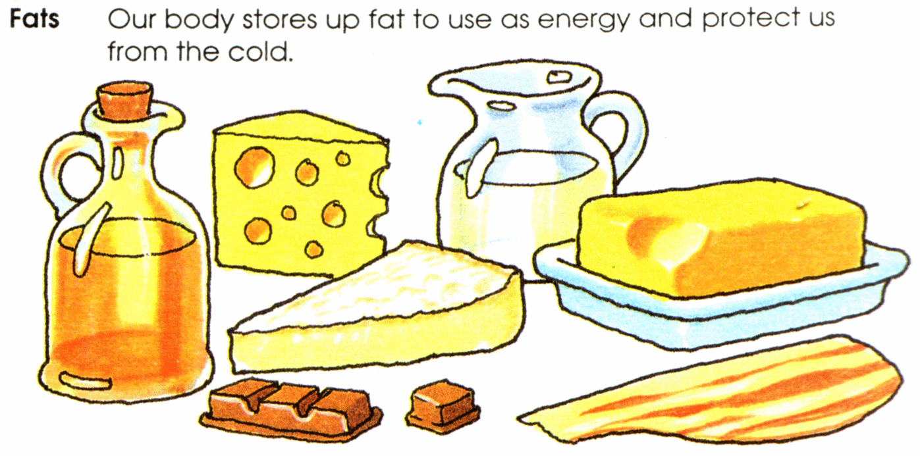
Lipids
Molecular Structure
Carbon
Hydrogen
Oxygen
More carbon-hydrogen bonds than carbohydrates and fewer oxygen atoms
Do Not dissolve in water
Examples:
Fats
Oils
Waxes
Phospholipids
Steroids
Function
1. Use for long -term energy storage
2. Protection against heat loss (insulation)
3. Protection against physical shock
4. Protection against water loss (waterproof an organism)
5. Major component of cell membranes (phospholipids)

Slide 20
Lipids
Triglycerides: composed of 1 glycerol and 3 fatty acids.
H
H-C----O
H-C----O
H-C----O
H
O
C-CH₂-CH₂-CH₂-CH₂-CH₂-CH₂-CH₂-CH₂-CH₂-CH₃
=
O
C-CH₂-CH₂-CH₂-CH₂-CH₂-CH₂-CH₂-CH₂-CH₂-CH₃
=
O
C-CH₂-CH₂-CH₂-CH
fatty acids
=
=CH-CH₂-CH₂-CH₂-CH₂-CH₃
glycerol

Slide 21
Fatty Acids
There are two kinds of fatty acids you may see these on food labels:
1. Saturated fatty acids: no double bonds (bad)
2. Unsaturated fatty acids: double bonds (good)
O
C-CH₂-CH₂-CH₂-CH₂-CH₂-CH₂-CH₂-CH₂-CH₂-CH₃
=
saturated
O
C-CH₂-CH₂-CH₂-CH
=
unsaturated
=CH-CH₂-CH₂-CH₂-CH₂-CH₃

Slide 22
summary of lipids
Macromolecule | Composition | Function
Lipids | Carbon Hydrogen Oxygen (form fats, oils and waxes) | Use for long -term energy storage Insulate and waterproof an organism Main substance that makes up biological membranes.

Slide 23
Proteins
Large organic molecules composed of Carbon, Hydrogen, Oxygen and Nitrogen
Made of Amino acids (20 different kinds of aa) bonded together by peptide bonds

Slide 24
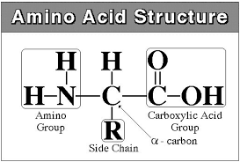
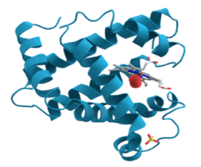
Amino Acid (monomer of proteins)
Amino acids contain an amino group (-NH2)on one end an carboxyl group (-COOH) on the other end.
The sequence and arrangement of amino acids determine the three-dimensional shape of the protein and its function in the cell.
The "R" group varies, giving each amino acid, specific properties (neutral, acid, bases; polar, non polar)

Slide 25
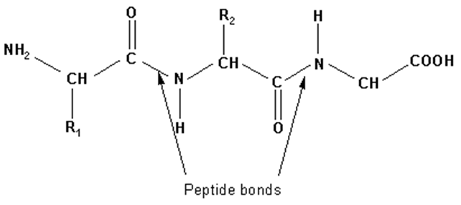
Amino Acids (aa)
aa1
aa2
aa3
aa4
aa5
aa6
Peptide Bonds

Slide 26
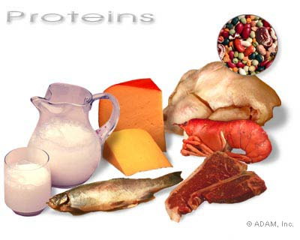
Proteins
Molecular Structure
Carbon
Hydrogen
Oxygen
Nitrogen
Made of amino acids
Peptide bonds hold two amino acids together
Function
Structural: Serve as the building
and connecting material of living
things
Collagen forms bones, ligaments,
tendons etc.
Functional: Control the rate of
chemical reactions and transport
materials.
Examples of Functional proteins:
Hormones, antibodies ,enzymes.
Enzymes control the rate of chemical
reaction. Enzymes speed up chemical
reactions by decreasing the activation
energy

Slide 27
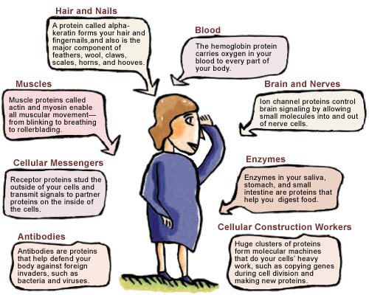
Proteins are worker molecules that are necessary for virtually every activity in your body.

Slide 28
Summary of Proteins
Macromolecule | Composition | Function
Proteins (made of amino acids) | Carbon Hydrogen Oxygen Nitrogen (form amino Acids) Peptide bonds hold two amino acids together | Structural: Serve as the building and connecting material of living things Collagen forms bones, ligaments, tendons etc. Functional: 1. Some control the rate of chemical reactions. Enzymes are proteins that control the rate of chemical reaction. Enzymes decrease the activation energy speeding up chemical reactions 2. Some Transport materials into and out of the cell. Protein carriers on the cell membrane. Hemoglobin transport oxygen. 3. Antibodies are proteins that fight diseases. 4. Hormones carry messengers

Slide 29
Nucleic Acids
Composed of Carbon, Hydrogen, Oxygen, Nitrogen and Phosphorous (CHONP)
Nucleic acids are composed of long chains of nucleotides
A Nucleotide includes:
phosphate group
pentose sugar (5-carbon)
nitrogenous bases:
adenine (A)
cytosine (C)
guanine (G)
thymine (T) DNA only
uracil (U) RNA only

Slide 30
Nucleotide
Phosphate
Group
O
O=P-O
O
5
CH2
O
N
Nitrogenous base
(A, G, C, or T)
C⁴
C¹
Sugar
(deoxyribose)
C³
C²

Slide 31
Nucleic acids
Two types:
a. Deoxyribonucleic acid (DNA- double helix)
b. Ribonucleic acid (RNA-single strand)
Nucleic acids are composed of long chains of nucleotides.

Slide 32
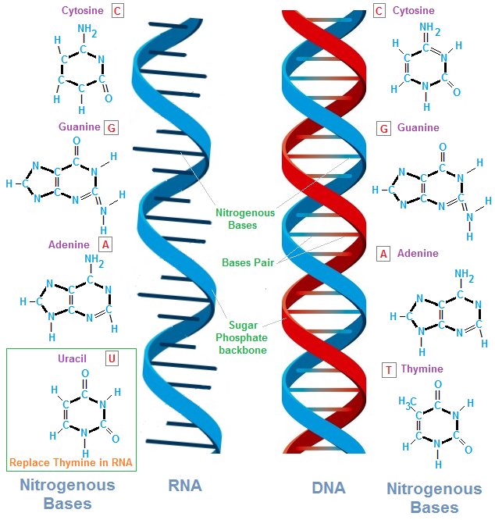

Slide 33
DNA - double helix
5
O
3
3
O
P
5
P
5
O
G
C
1
2
3
4
4
2
1
3
5
P
O
P
T
A
3
5
O
O
5
P
P
3

Slide 34
Nucleic acids
Molecular Structure
Carbon
Hydrogen
Oxygen
Nitrogen
Phosphorous
Nucleic acids are
composed of nucleotides
A Nucleotide include:
phosphate group
pentose sugar (5-carbon)
a nitrogenous base
Types DNA and RNA
Function
1.Store, copy, and transmit genetic
information in the form of a code.
2. Genetic information is stored in DNA
3. Information in DNA is then translated by RNA and use to direct the production of proteins.

Slide 35
SUMMARY OF NUCLEOTIDES
Macromolecule | Composition | Function
Nucleic Acids (made up nucleotides) | Carbon Hydrogen Oxygen Nitrogen Phosphorous (form DNA and RNA) | Store, copy, and transmit information in the form of a code. The most important nucleic acids are DNA and RNA Genetic information is stored in DNA Information in DNA is then translated by RNA and use to direct the production of proteins.

Slide 36
Energy from macromolecules
Carbohydrates, proteins, and lipids can all serve
as energy sources for cells.
Carbohydrates and proteins yield only four calories per gram.
Lipids nine calories per gram.
Carbohydrates are the best source of quick energy.
Proteins are broken down more slowly than
carbohydrates .
As a result, proteins are a longer- lasting source of energy.
Organisms convert carbohydrates and proteins that are not needed for energy into lipids. Cells store energy in these lipids

Slide 37
Macromolecule | Composition | Function
Carbohydrates | Carbon Hydrogen Oxygen (form sugars) | Main source of energy for cells Short term energy storage Structural support: cellulose in plant cell’s walls
Lipids | Carbon Hydrogen Oxygen (form fats, oils and waxes) | Use for long term energy storage Insulate and waterproof an organism Main substance that makes up biological membranes.

Slide 38
Macromolecule | Composition | Function
Proteins (made of amino acids | Carbon Hydrogen Oxygen Nitrogen Peptide bonds hold two amino acids together | Structural: Serve as the building and connecting material of living things Collagen forms bones, ligaments, tendons etc. Functional: Play a role in chemical reactions and transport of materials. Hormones, antibodies ,enzymes. Enzymes control the rate of chemical reaction. Enzymes decrease the activation energy speeding up chemical reactions
Nucleic Acids | Carbon Hydrogen Oxygen Nitrogen Phosphorous (form DNA and RNA) | Store and transmit information in the form of a code. The most important nucleic acids are DNA and RNA Genetic information is store in DNA Information in DNA is then translated by RNA and use to direct the production of proteins.

Slide 39
1. Animals breathe in oxygen (O₂). This O₂ is used in their bodies in the breakdown of the glucose and fatty acids. The main function of the breakdown of glucose and fatty acids is to provide energy for chemical reactions by producing which of the following?
a. enzymes
b. deoxyribonucleic acid
c. adenosine triphosphate
d. proteins

Slide 40
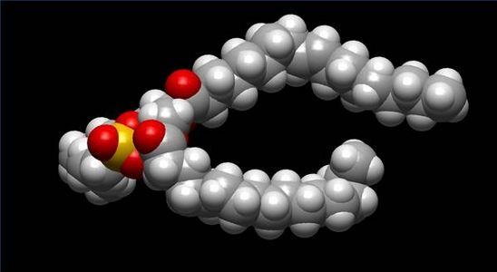
2.What biological macromolecule is generally insoluble in water and functions in an important role in biological membranes?
a. carbohydrates
b. proteins
c. nucleic acid
d. lipids

Slide 41
3. Proteins are one of four classes of biological macromolecules. Which of the following statements about proteins is NOT correct? a. Enzymes are specific types of proteins. b. There are 20 different amino acids that make up proteins.
c. All R chains on the amino acids that make up proteins are polar and acidic.
d. Peptide bonds form between amino acids in a dehydration reaction, creating proteins

Slide 42
4. Both lipids & carbohydrates are important in the cell because both a. provide insulation.
b. store energy.
c. contain nitrogen.
d. contain cell walls

Slide 43
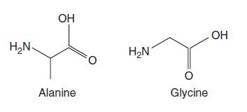
?
5.The diagram below shows two amino acids. What would biochemists call the result of chaining two or more of these molecules together?
a. carbohydrate
b. lipid
c. nucleic acid
d. protein

Slide 44
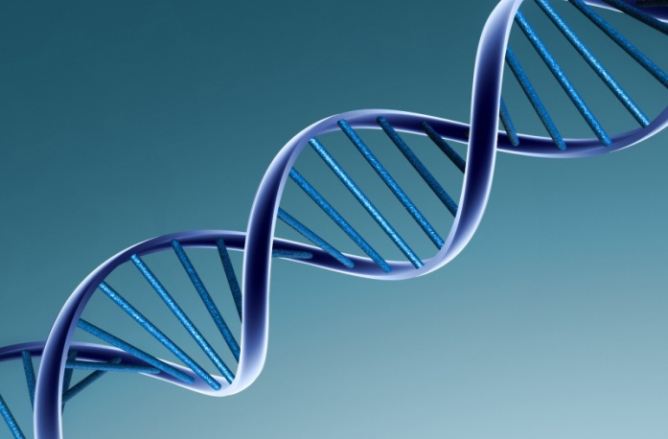
6.Which of the following best describes the major function of the biological macromolecule DNA?
a. provides the energy required by the cell
b. synthesizes RNA
c. stores information that translates into making proteins
d. decreases the activation energy required for a reaction

Slide 45
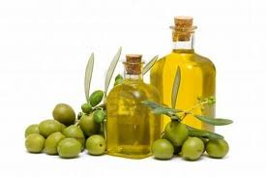
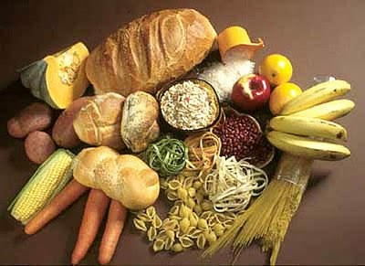
7. Which answer best describes how carbohydrates and lipids are similar?
a. Both contain fats and oils and have an important structural function within the cell.
b. Both are polymers that are linked by peptide bonds.
c. Both are nucleic acids involved in making ATP.
d. Both contain carbon, hydrogen, and oxygen, and are broken down as a source of energy.

Slide 46
8. Which biological molecule transports substances, speeds up reactions, makes hormones, and provides structural support?
a. carbohydrates
b. proteins
c. deoxyribonucleic acid
d. adenosine triphosphate

Slide 47
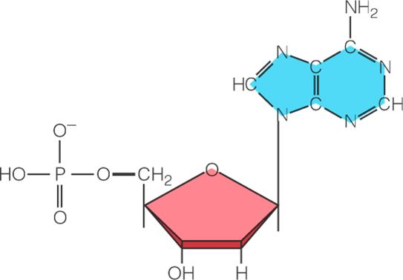
9. Nucleotides consist of a phosphate group, a nitrogenous base, and which of the following?
a. fatty acids
b. an amino acid
c. a 5-carbon sugar
d. glycerol

