Slide 1
33_The Cardiovascular System
SC.L.14.36: Factors that affect blood flow through the circulatory system

Slide 2
Cardiovascular System
The human cardiovascular system is made up of:
1. The Heart
2. Blood: Red blood cells, white blood cells and platelets
3. Blood Vessels: Arteries, Veins and Capillaries
Together function to transport materials (nutrients and oxygen), remove wastes (carbon dioxide), and distribute heat.

Slide 3
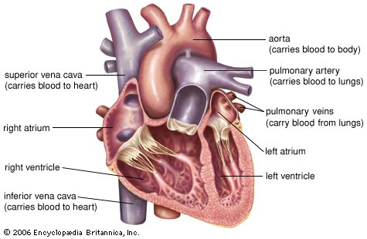
The Heart
Made up mostly of cardiac muscle tissue, which contracts to pump blood.

Slide 4
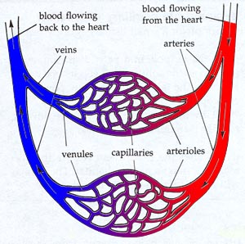
Blood Vessels
allow for the movement of blood to all cells in the body.
The pumping action of the heart, however, is needed to provide enough pressure to move blood throughout the body.
Include:
Arteries: Move blood away from the heart
Veins: Return blood to the heart
Capillaries: Connect arterioles and venules, and allow the diffusion of oxygen into the cells, and removal of carbon dioxide

Slide 5
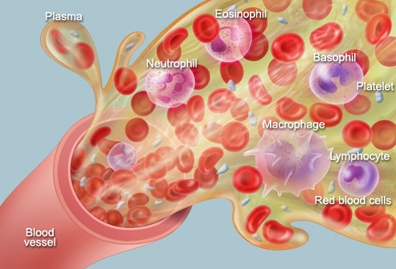
The blood
Blood is a constantly circulating fluid providing the body with nutrition, oxygen, and waste removal.
Blood is mostly liquid, with numerous cells and proteins suspended in it, making blood "thicker" than pure water.

Slide 6
Blood composition
A liquid called plasma makes up about half of the content of blood.
contains proteins that help blood to clot,
transport substances through the blood, and perform other functions.
also contains glucose and other dissolved nutrients.
About half of blood volume is composed of blood cells:
Red blood cells, which carry oxygen to the tissues
White blood cells, which fight infections
Platelets, smaller cells that help blood to clot
Blood is conducted through blood vessels (arteries and veins). Blood is prevented from clotting in the blood vessels by their smoothness, and the finely tuned balance of clotting factors

Slide 7
What factors affect blood flow through the circulatory system?
Blood pressure
Blood volume
Resistance
Disease
Exercise.

Slide 8
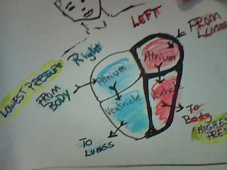
Blood Flow and Pressure Gradient
Highest Pressure at left Ventricle--Squeezes blood to aorta and out to the body
Lowest pressure is blood returning to heart at right Atrium—Squeezes to right Ventricle, to lungs to get oxygen
From lungs to left atrium and back to left ventricle
Cells

Slide 9
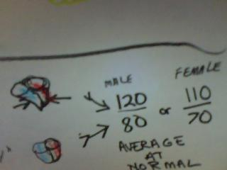
Blood Pressure
Systole—Squeeze, contraction
Diastole—Fill, “dreamy”
Blood Pressure measurement is taken during systole and diastole of left ventricle
The top number is systole
The lower number is diastole
Normal for average male is 120/80
Normal for average female is 110/70

Slide 10
Blood Pressure
Force on vessel walls
Highest as left ventricle squeezes, contracts
Lowest at right atrium
when blood comes from the body
Pressure gradient (difference in pressure)
Systole/diastole = ventricle squeeze/ventricle fill

Slide 11
Blood Volume
About 5.25 Liters of blood in a person
Stroke Volume—Amount of blood in each beat
How much blood in ventricle
How hard the contraction, squeeze
How much resistance in vessels
Cardiac Output—Amount of blood in one minute
Stroke Volume times Heart Rate
Average male—5.25L/minute

Slide 12
Resistance
What is Resistance?
Is the force that slows down blood flow.
What causes resistance?
The blood as it touches vessel walls.
Three main sources of peripheral resistance:
1. blood vessel diameter
2. blood viscosity
3. total vessel length

Slide 13
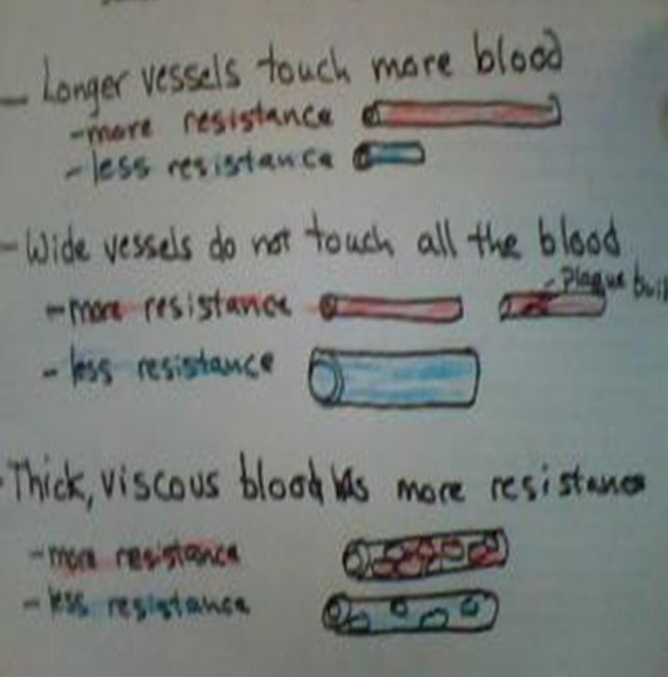
Sources of Resistance
Blood vessel diameter
As a the diameter of a tube gets smaller, a greater proportion of the fluid is in contact with the wall of the tube. Therefore resistance to flow is increased and pressure rises
Constriction of blood vessels raises blood pressure
Total Vessel Length
Longer vessels touch more blood than shorter vessels.
Viscosity
Is related to the thickness of a fluid.
The greater the viscosity, the less easily molecules slide past one another and the more difficult it is to get the fluid moving and keep it moving.
Because of this greater resistance to flow, a greater pressure is required to pump the same volume of viscous fluid.

Slide 14
Factors That Affect Blood Flow
Blood Pressure (covered)
Blood Volume (covered)
Resistance (covered)
Disease
Exercise

Slide 15
What diseases affect the blood flow?

Slide 16
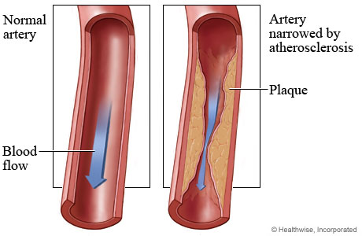
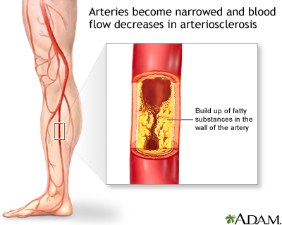
Atherosclerosis
A diet high in cholesterol causes a disease known as atherosclerosis.
Blood vessels become less elastic, which can lead to high blood pressure.

Slide 17
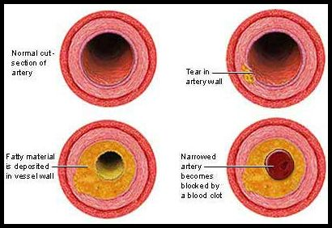
The fatty material is deposited in arteries. If a coronary artery is blocked by a blood clot is causes a heart attack, and if blockage is at the brain it causes a stroke.

Slide 18
Diabetes
Diabetes is one of the many medical conditions that slow down blood flow.
In diabetes, there is an elevated level of sugar in the blood.
This increase in glucose causes the blood to be viscous or thicker causing the flow to decrease.

Slide 19
Sickle Cell Anemia
Genetic disease—painful, tired
Normal red blood cell become “C” shaped
Cells get stuck, block vessels and clump together
Blood transfusions

Slide 20
Diet High in Salt
A diet high in salt retains water
which increases blood volume and
the blood pressure increases.

Slide 21
Hypertension
Blood pressure in arteries is elevated (140 / 90 or higher)
Caused by atherosclerosis: If arteries lose their elasticity and become more rigid, blood pressure increases
Hypertension causes small tears in blood vessels, setting the stage for atherosclerosis.
Uncontrolled hypertension can lead to:
Heart attack
Stroke
Kidney damage

Slide 22
Smoking
Smoking causes vessels to constrict (narrow) which increases blood flow through the body

Slide 23
Exercise
Increases blood pressure
Increases blood flow
More blood to muscles and less to stomach
Same blood to brain
Heart beats faster and harder to get more oxygen to cells

Slide 24
Test
Which side of heart is deoxygenated?
Where does blood from the left ventricle go?
The part of the heart beat in which the ventricles fill is called _______.
Highest blood pressure is found ________.
Average female has blood pressure of __________.
There is about ________ of blood in a person.
Cardiac Output is the amount of blood per _______.

Slide 25
Answers
Right
The body
Diastole
Left ventricle
110/70
5.25L
Minute

Slide 26
Test
List 3 factors that cause more resistance.
Viscosity means ________.
High Blood Pressure can cause _______.
Sickle Cells are a problem because they ________.
4 ways to keep your heart healthy: __________.
Exercise increases blood ________ .

Slide 27
Viscosity of the blood, length, and diameter of blood vessels
Thickness
Heart failure, stroke
Block blood flow, stick together
No smoking or overeating, eat fruits and veggies, exercise
Flow and pressure

